Slide 1
Annual Review
Studies of VO₂ Thin Films with Ultrafast pulses and Raman spectroscopy.
Elizabeth Radue
3/11/12

Slide 2
Course Requirements
Entered program in 2010
Completed all core class requirements
Electives
  Out of Field: completed
  In Field: in process
Completed Qualifying Exam: Summer 2011

Slide 3
Research
Working in Irina Novikova’s Lab, (closely with Lukaszew)
Collaboration working on VO₂ thin films
Notes:
Summer 20011

Slide 4
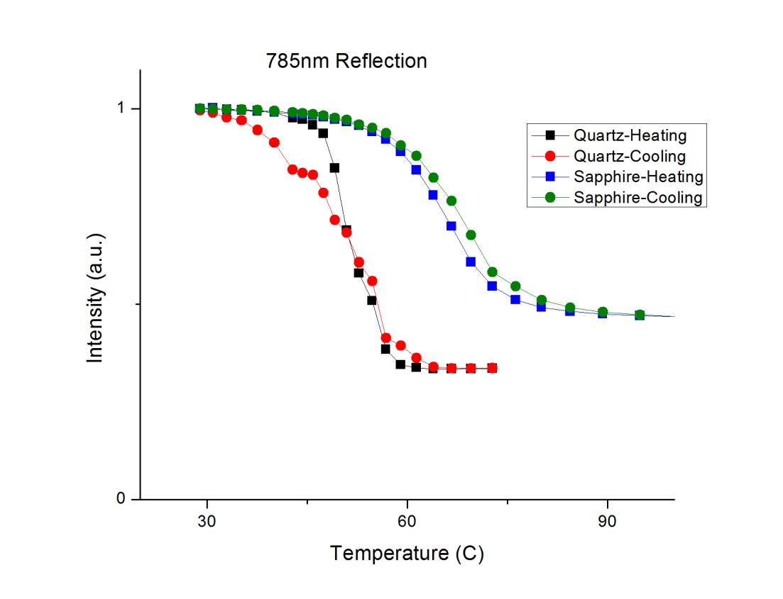
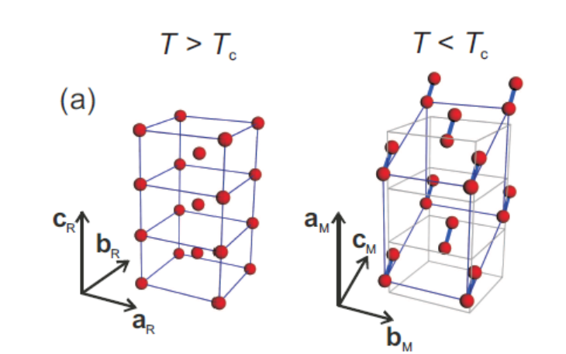
VO₂ Insulator Metal Transition
VO₂ transition from insulator to metal when heated or optically stimulated

Slide 5
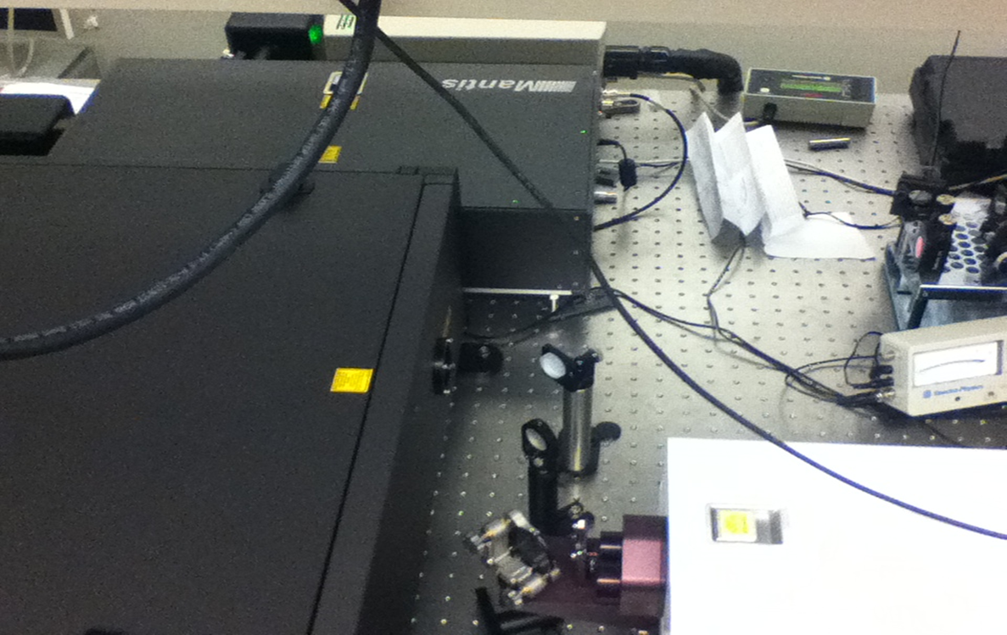
Ultrafast Laser system
100fs pulse with repetition rate of 1kHz
800nm: optional wavelengths from 400nm-1600nm

Slide 6

Pump-probe Experimental Set up
Variable ND filter
Legend Elite 800nm
Lock-in Amplifier
Computer
Variable Delay
Detector
$Vo_{2}$ sample

Slide 7
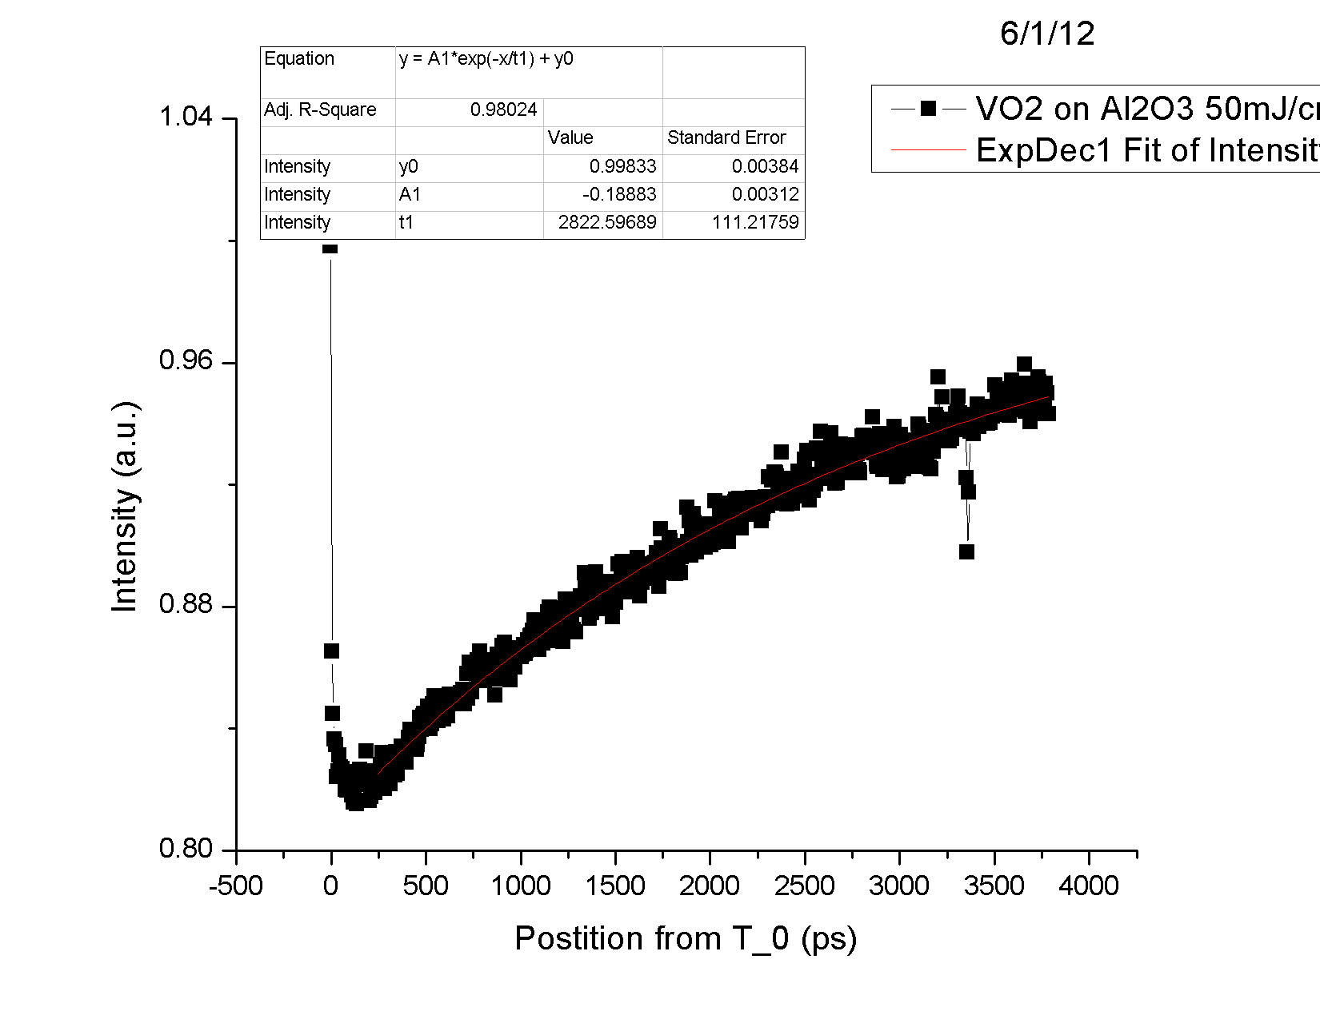
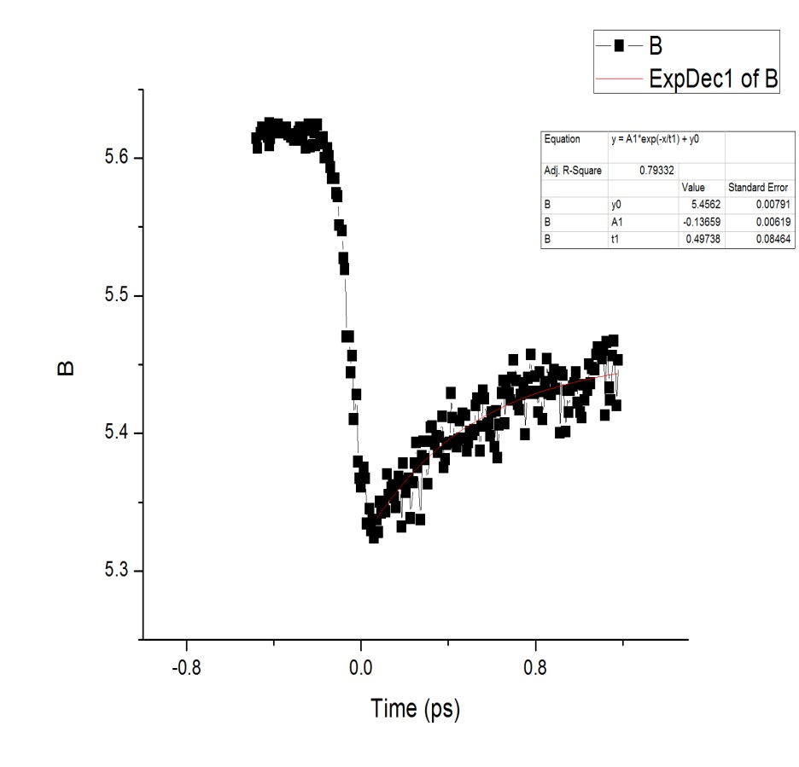
Observe transition by observing change in reflectivity

Slide 8
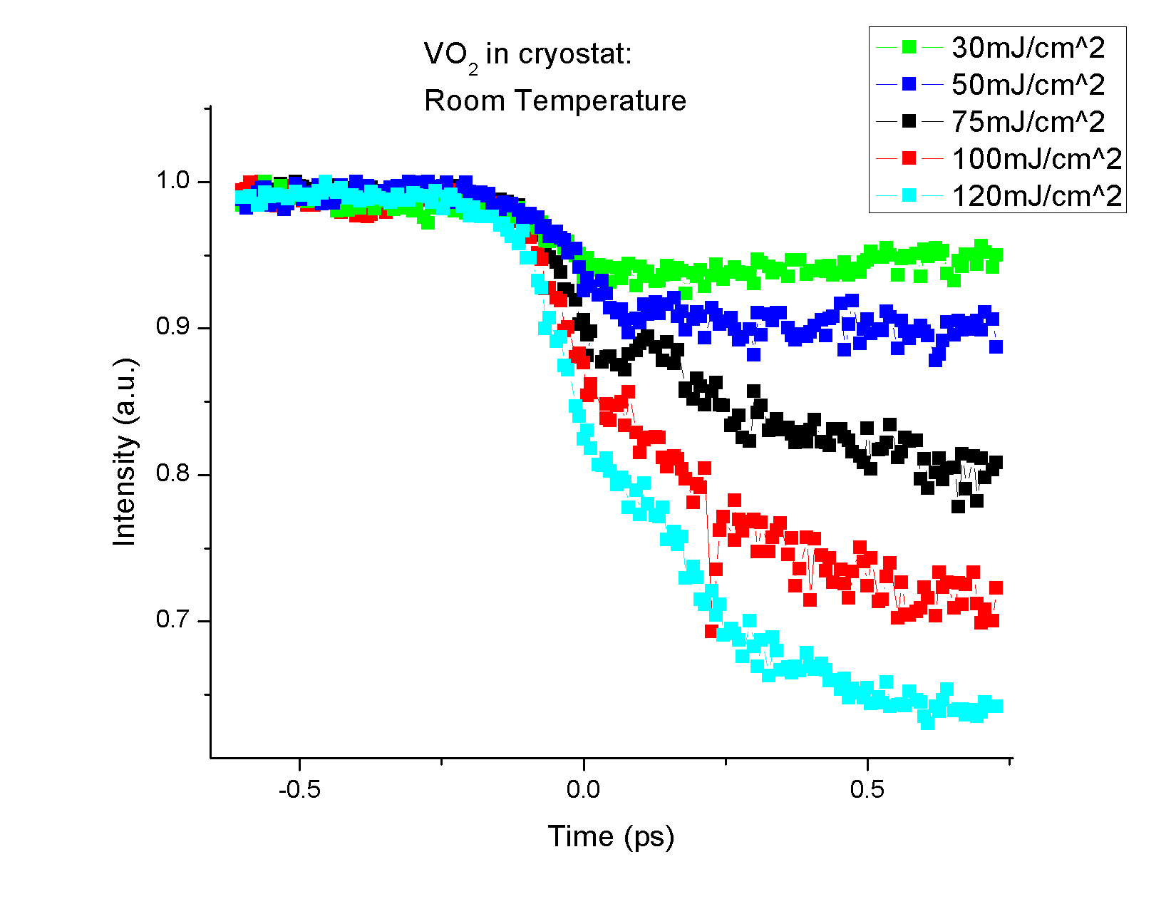
Intensity of Probe beam

Slide 9
Why mount films in a cryostat?
Effects of Temperature vs. Strong electric fields freeing electrons
→ Some controversy as to the main cause: fast response suggests electronic response vs. change in crystal lattice
T. Cocker, L. Titova, S. Fourmaux, G. Holloway, H.-C. Bandulet, D. Brassard, J.-C. Kieffer, M. El Khakani, and F. Hegmann, Physical Review B 85, 155120 (2012).
D. Hilton, R. Prasankumar, S. Fourmaux, a. Cavalleri, D. Brassard, M. El Khakani, J. Kieffer, a. Taylor, and R. Averitt, Physical Review Letters 99, 226401 (2007).

Slide 10
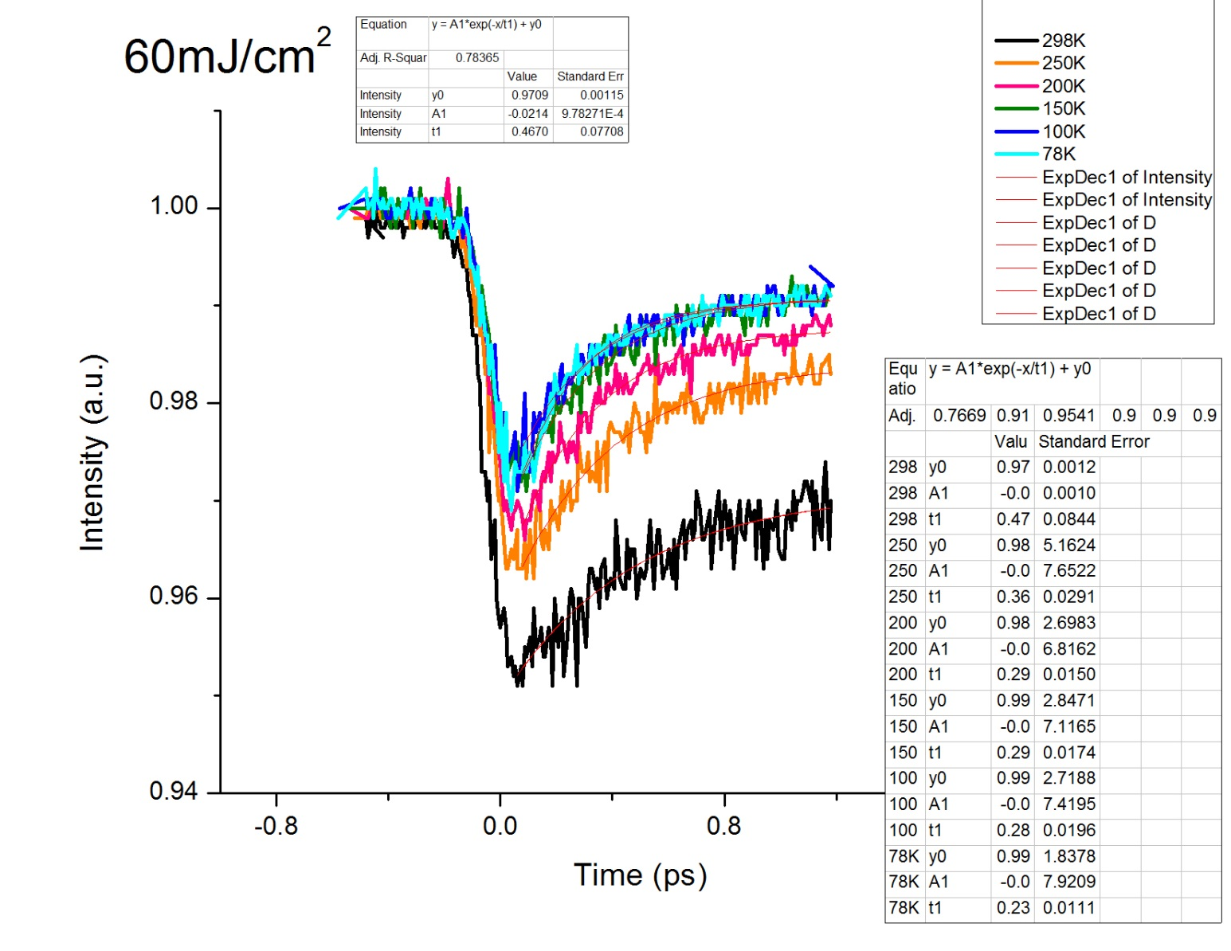
Varying temperature in Cryostat

Slide 11
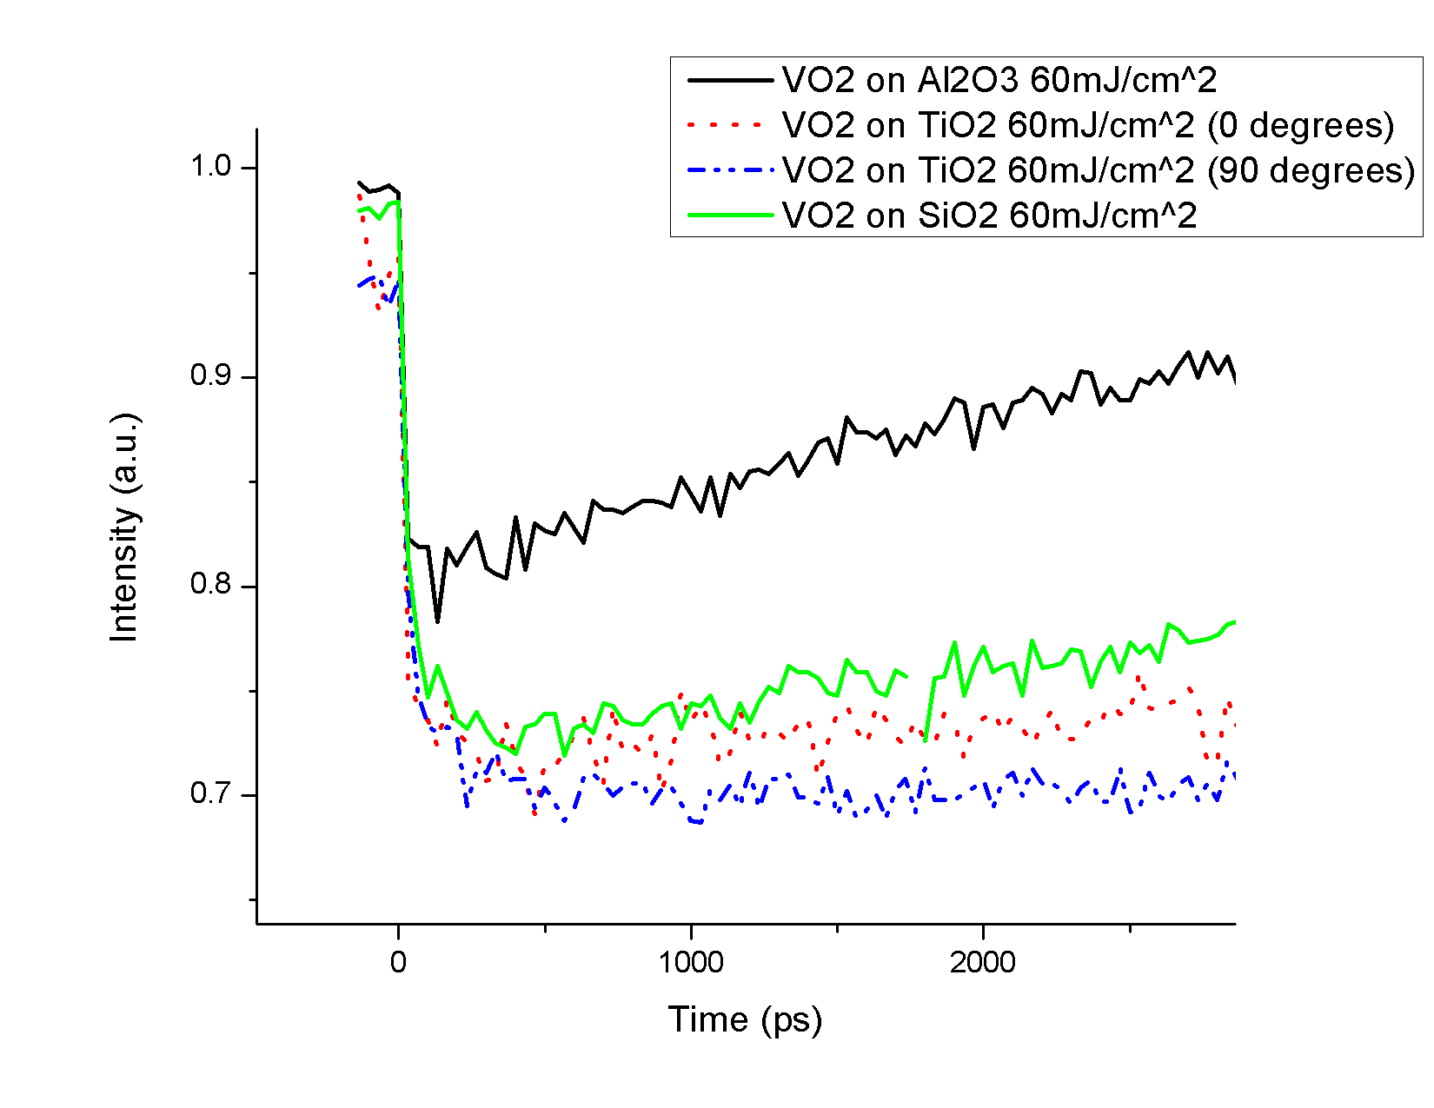
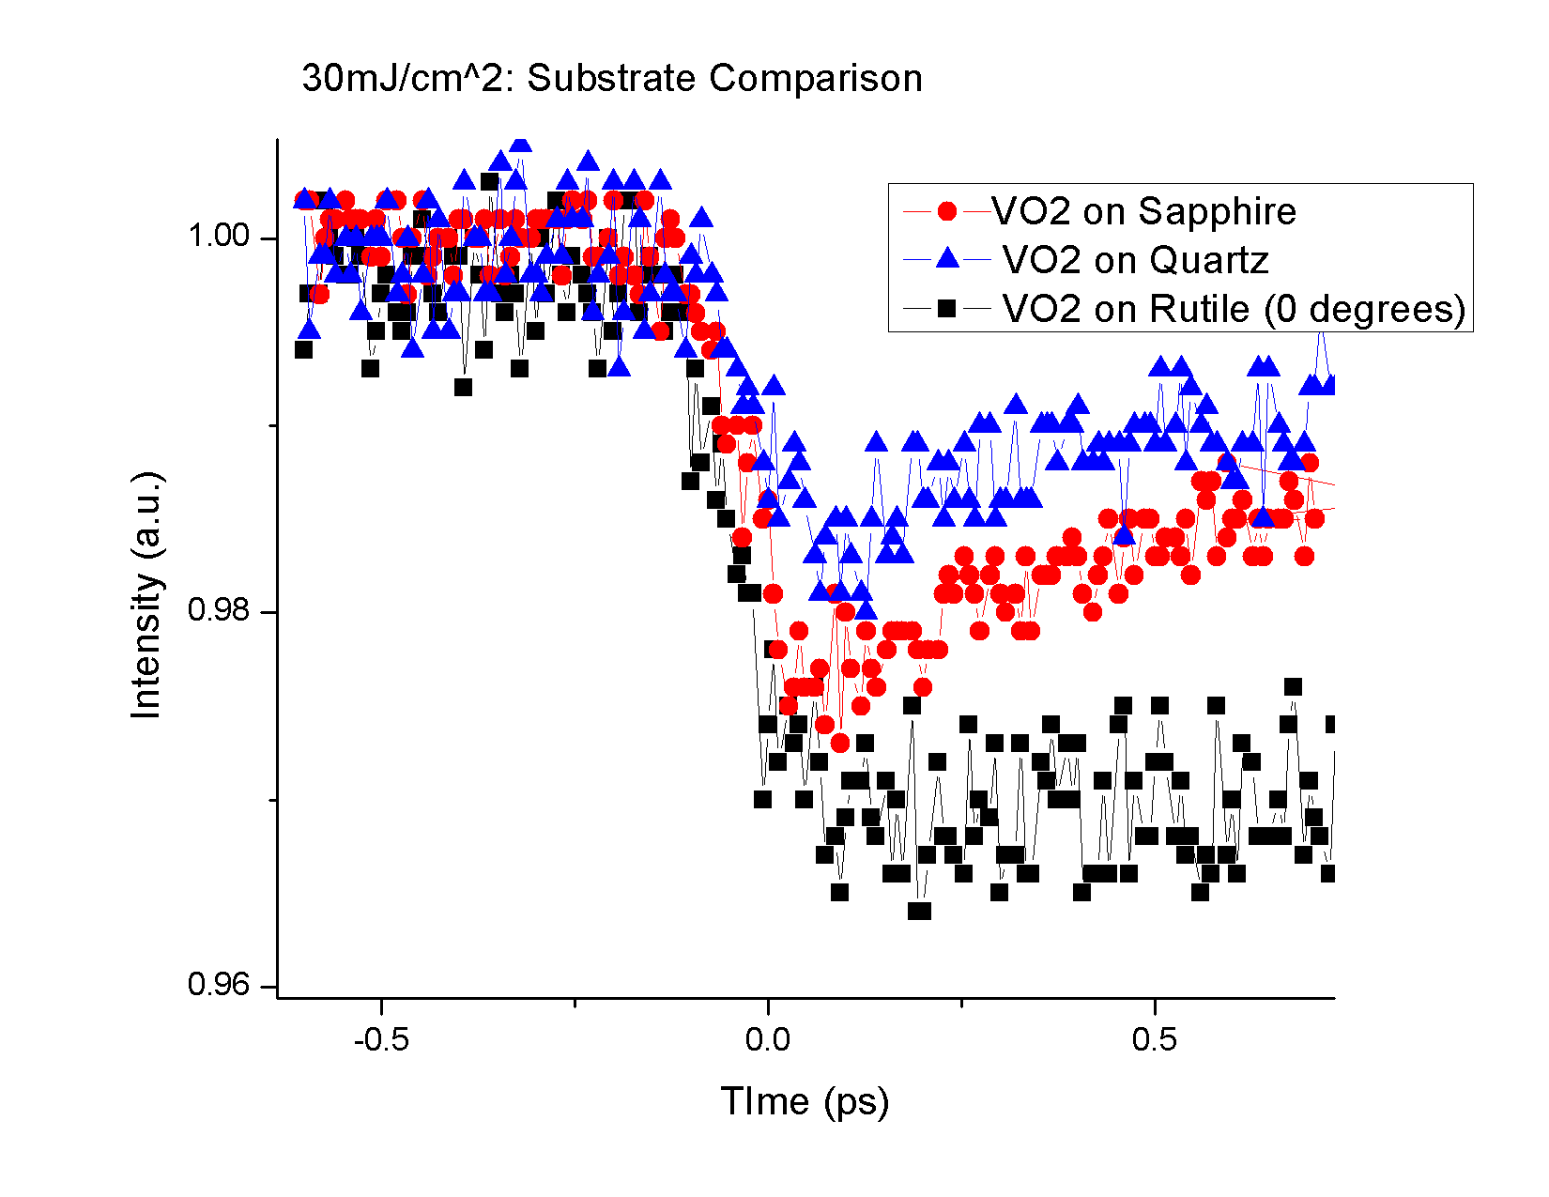
Different Substrates
Different Recovery Responses

Slide 12
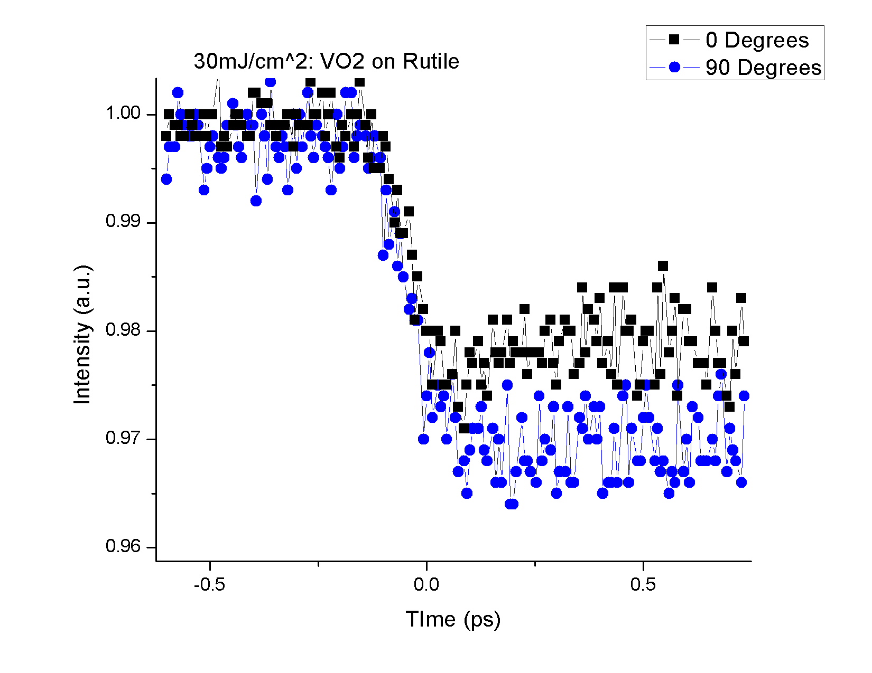
Anisotropy w/ TiO₂

Slide 13
Raman Spectroscopy
Collaboration with Buzz Wincheski at NASA Langley
Backscattering configuration
Tried different wavelengths for incident beam
Compared films on different substrates

Slide 14
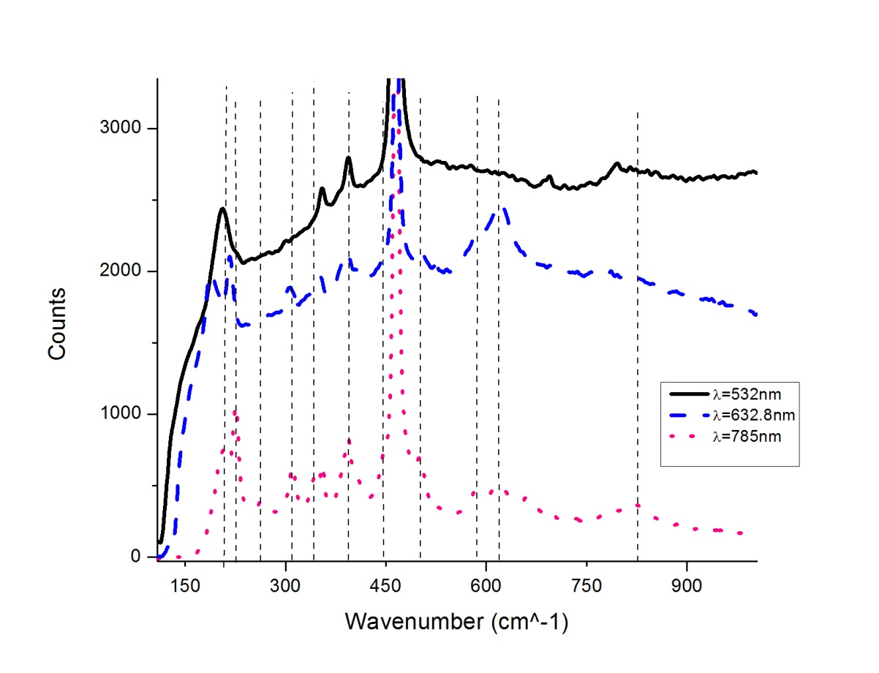
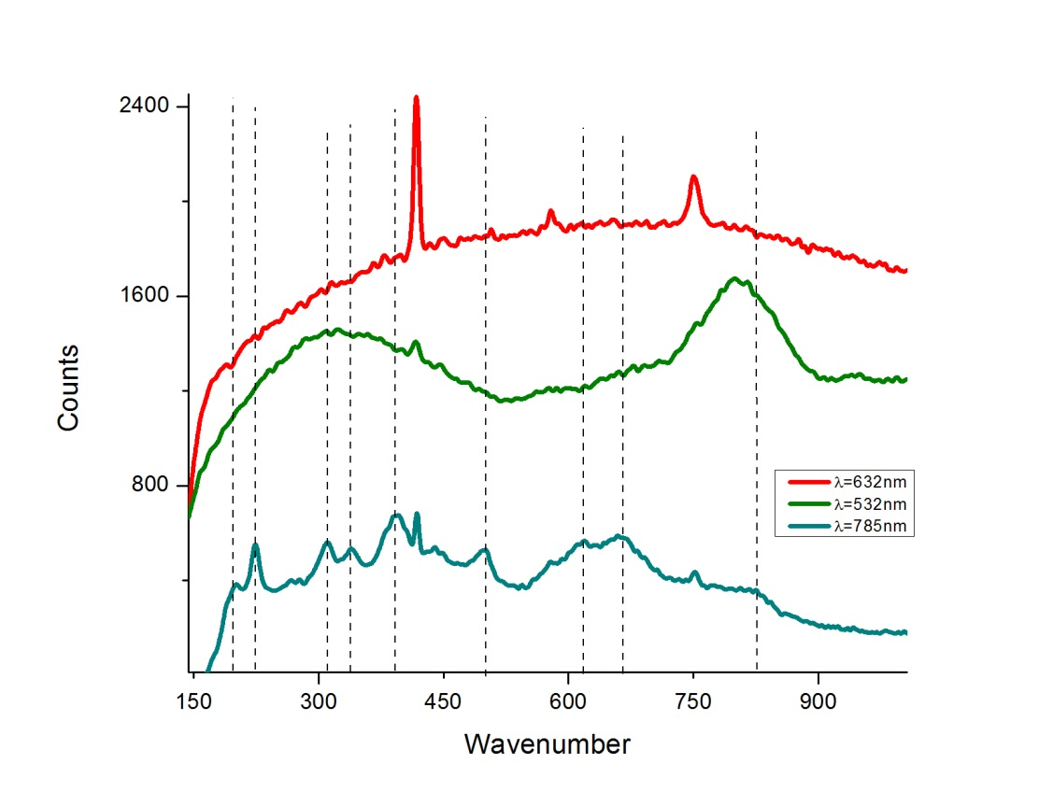
Different wavelengths
VO₂ on quartz
VO₂ on sapphire

Slide 15
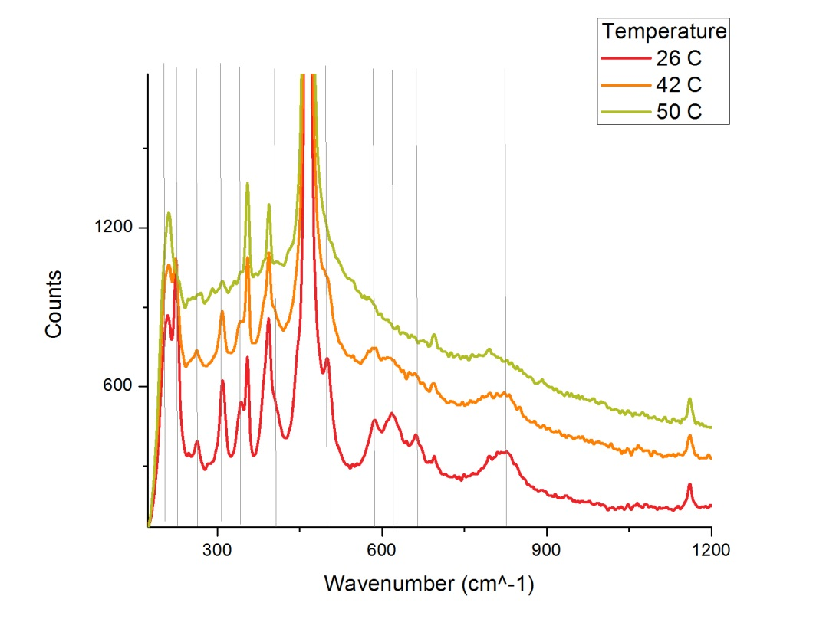
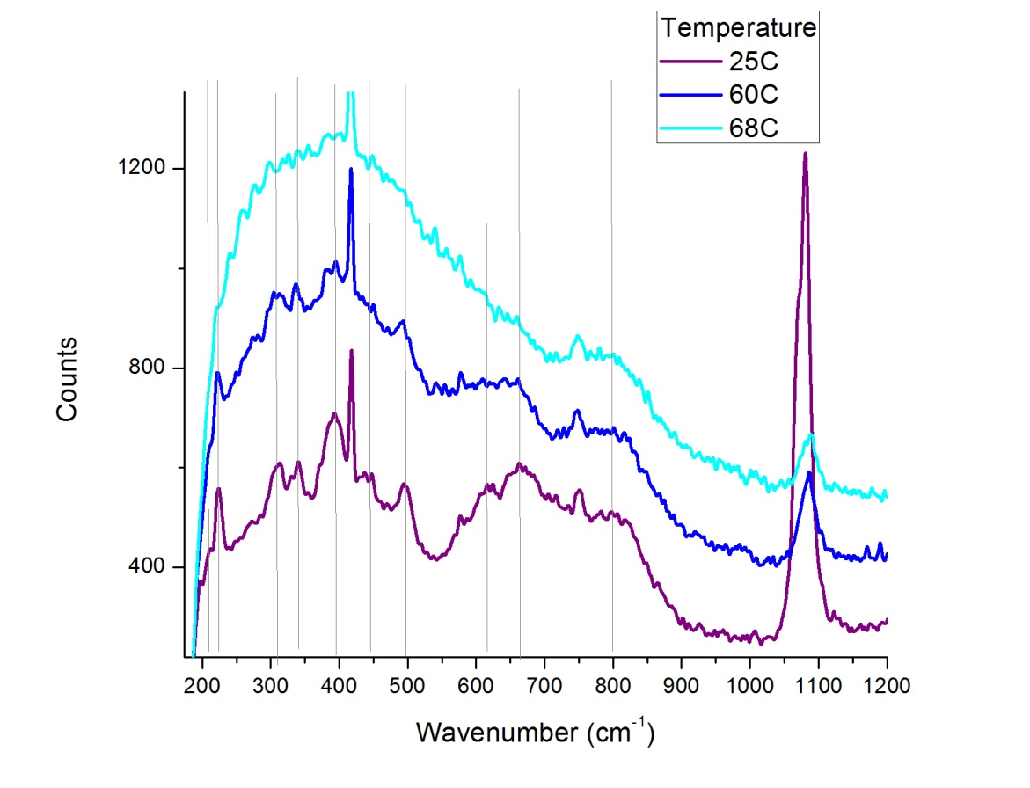
Raman Spectra through IMT
VO₂ on quartz
VO₂ film on sapphire

Slide 16
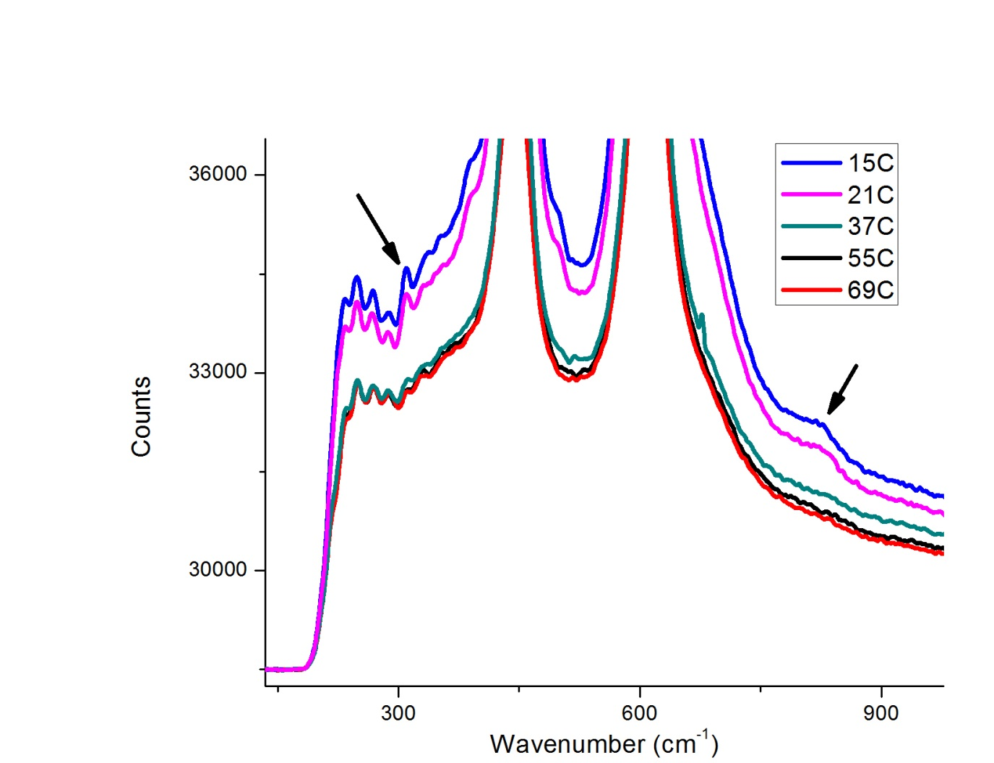
VO₂ on TiO₂

Slide 17

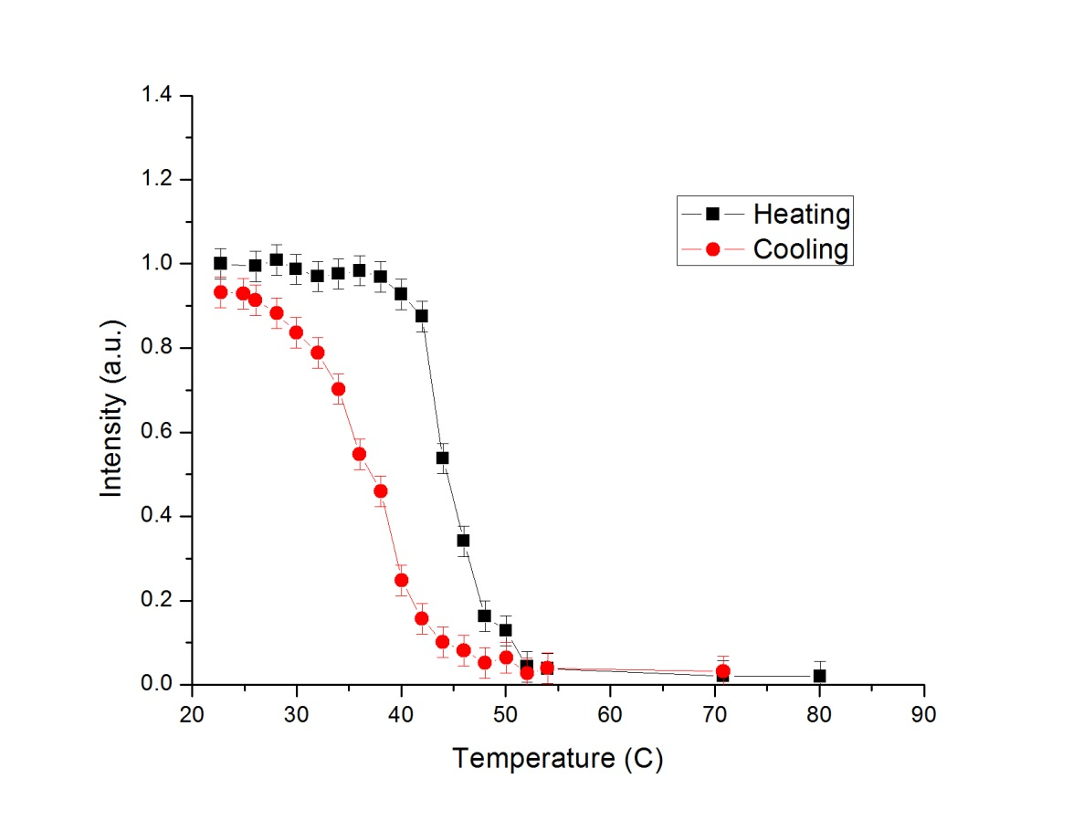
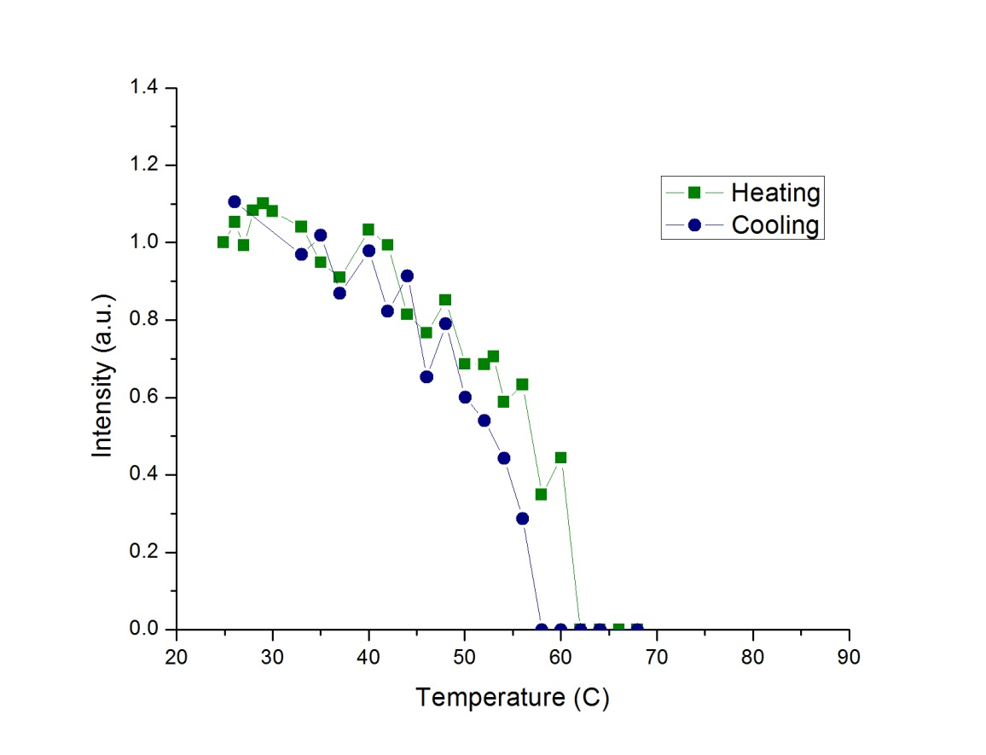
Peak 224cm⁻¹ fit
VO₂film on sapphire
VO₂ film on quartz

Slide 18
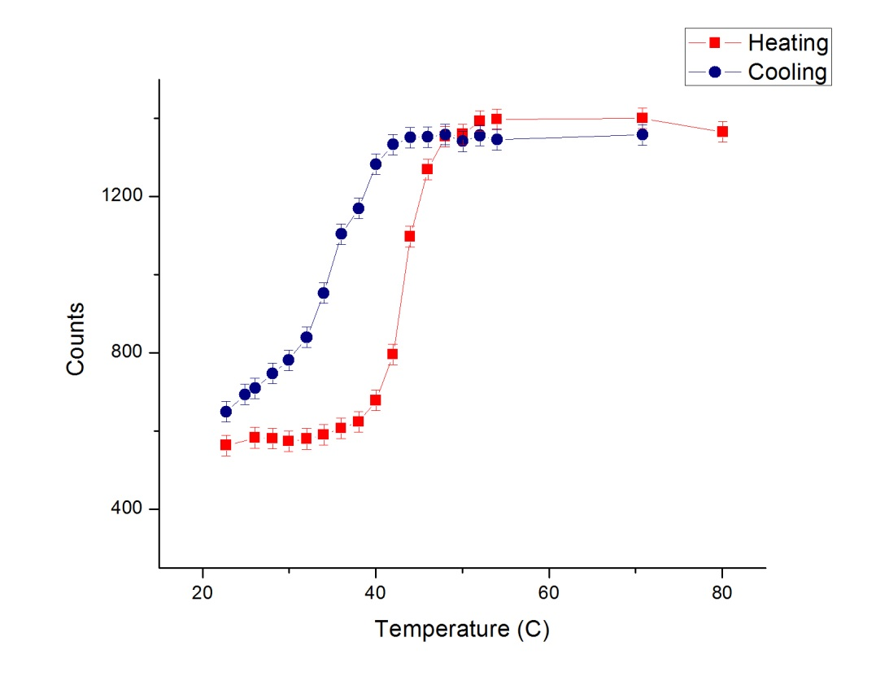
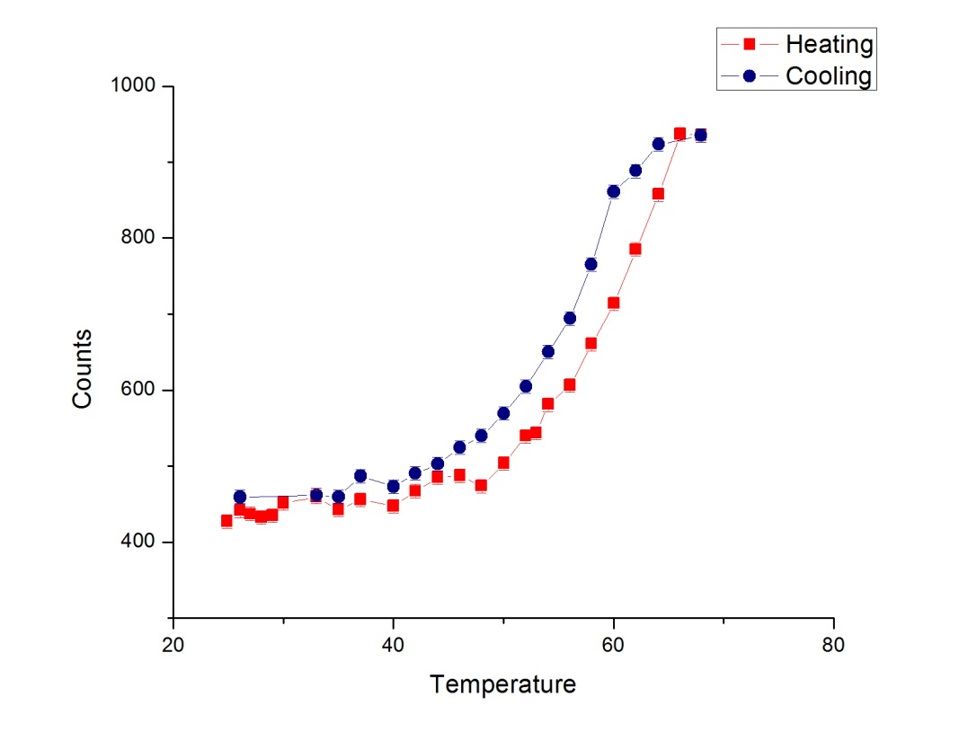
Change in background levels in peak fitting
VO₂film on sapphire
VO₂ film on quartz

Slide 19
Plans for the Future
Immediate:
  New XRD allows for growth of new films
  Writing up results for Raman spectroscopy
  Build autocorrelator for beam characterization
Down the Road:
  Use pump probe to study dynamics of surface plasmon polaritons
  Graduate 2016

Slide 20
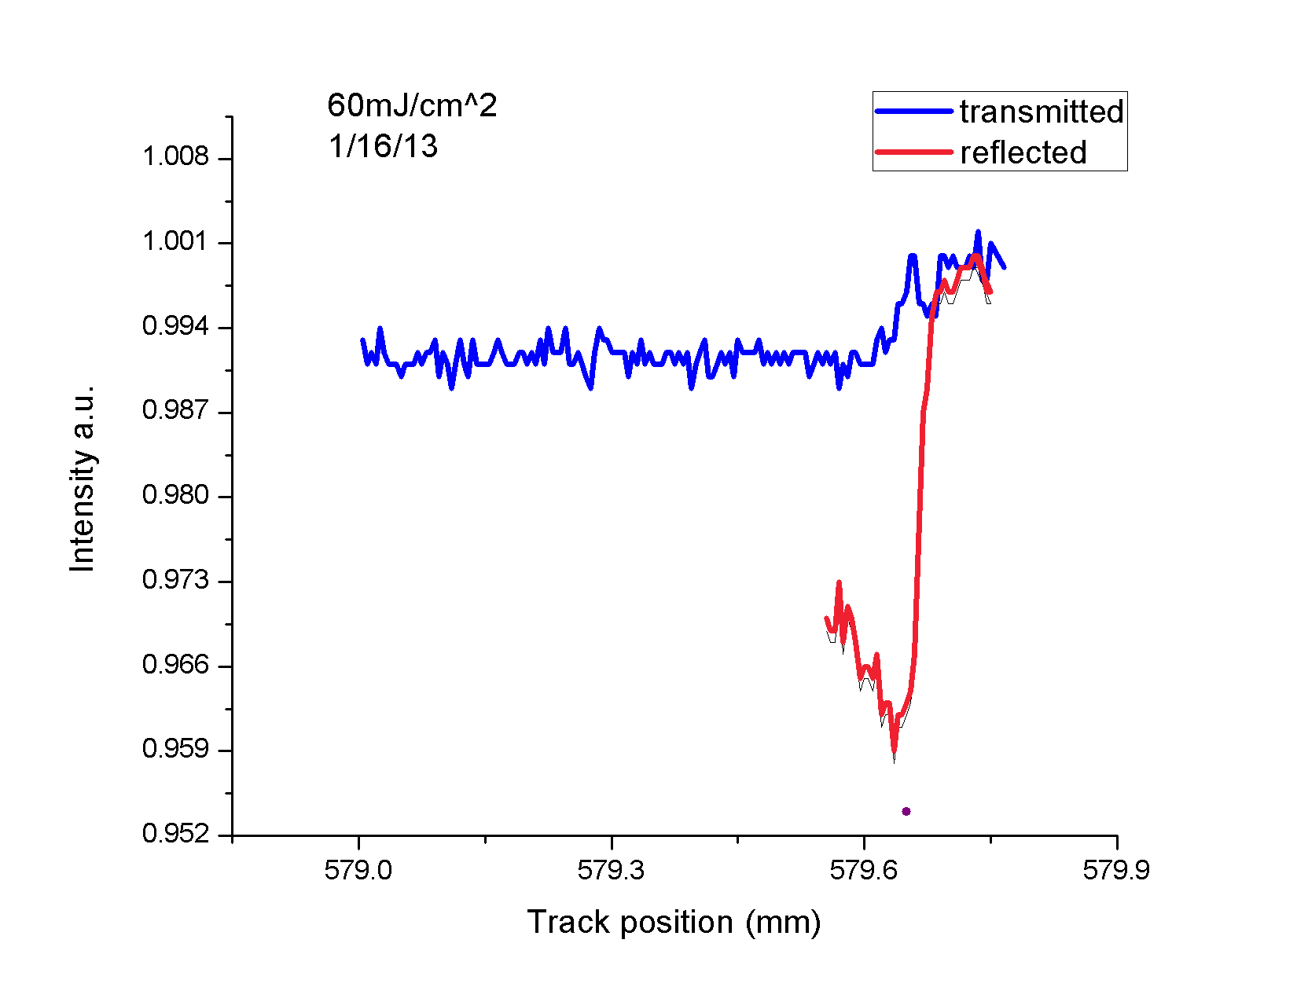
Transmitted vs. Reflected Beam

Slide 21
XRD
VO₂ on Quartz
VO₂ on Sapphire
VO₂ on TiO₂

Slide 22
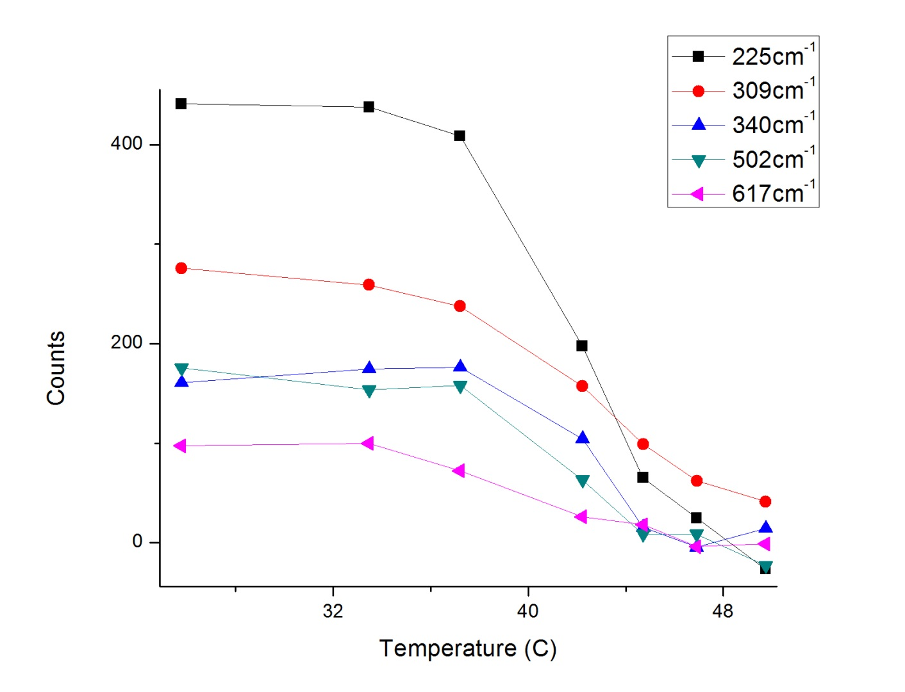
Multiple peak fits on VO₂ on SiO₂

Slide 23
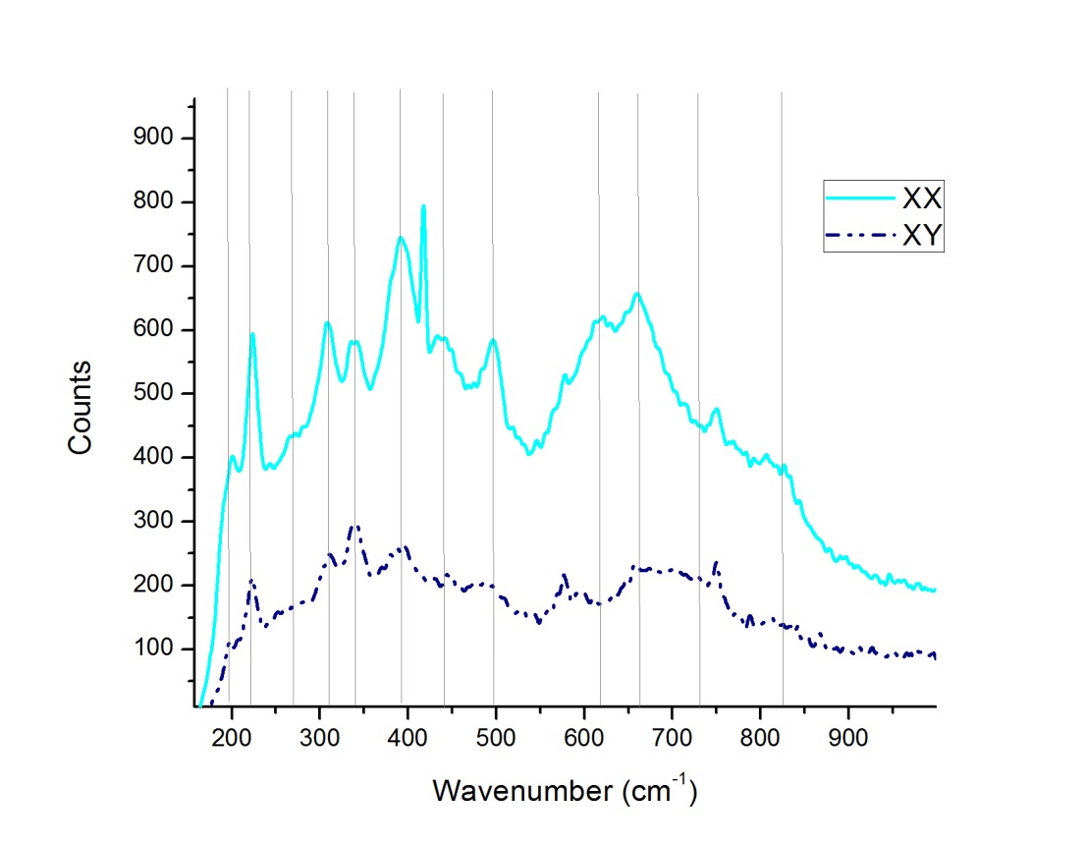
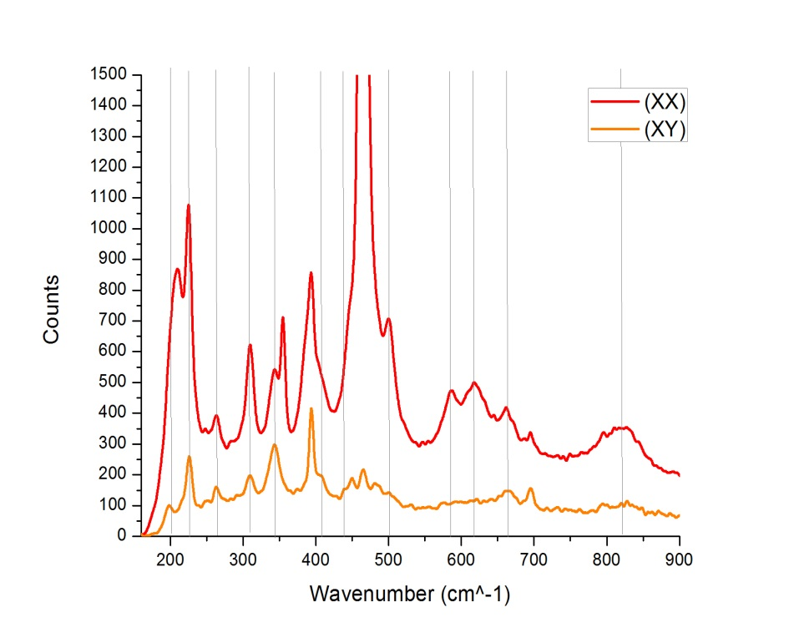
Polarization of incident/reflected beam

