Slide 1
Study of Spatial Structure of a Squeezed Vacuum Field
Ph. D Defense
Mi Zhang
Advisor: Eugeniy E. Mikhailov
March 20 2017

Slide 2
Outline
Motivation
Introduction
Correlation of self focusing and squeezing
Multi-mode structure of a squeezed vacuum field
Optical depth and its influence on squeezing
Pump shape and LO shape
Observation of beam noise
Conclusion

Slide 3
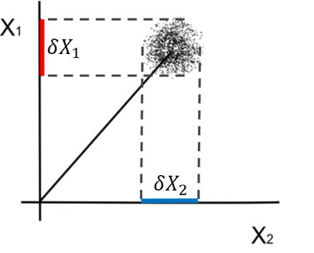
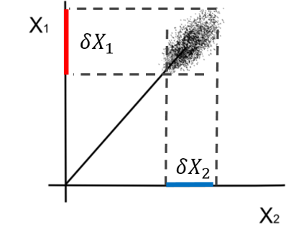
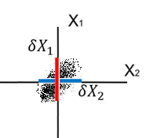
Squeezed field
Quantum Fluctuations in Light field:
$$\hat{X}={\hat{X}}_{1}+δ{\hat{X}}_{1}+i\left({\hat{X}}_{2}+δ{\hat{X}}_{2}\right)$$
Coherent State
Standard Quantum Limit
$$δX_{1}=δX_{2}$$
$$δX_{1}δX_{2}=\frac{1}{4}$$
Squeezed State
Squeezed Quantum Noise
$$δX_{1}≠δX_{2}$$
$$δX_{1}δX_{2}≥\frac{1}{4}$$
Precision measurements
-Magnetometer
-LIGO
Quantum imaging
Quantum information
Squeezed Vacuum State
$$δX_{1}≠δX_{2}$$
$$δX_{1}δX_{2}≥\frac{1}{4}$$

Slide 4
Why one should care about squeezed field
Precision measurements
-Magnetometer
-LIGO
Quantum imaging
Quantum memory

Slide 5
Polarization self rotation effect
Elliptically polarized light
rotates by $φ_{SR}=gεL.$
For linearly polarized light, the orthogonal
polarization gets squeezed.
Predictions of the PSR-generated squeezing in the Rb atomic vapor : - 8 dB
Current best : - 3 dB
A. B. Matsko, I. Novikova, G. R. Welch, D. Budker, D. F. Kimball, and S. M. Rochester
Phys. Rev. A 66, 043815 – Published 30 October 2002
S. Barreiro, P. Valente, H. Failache, and A. Lezama
Phys. Rev. A 84, 033851 – Published 28 September 2011

Slide 6
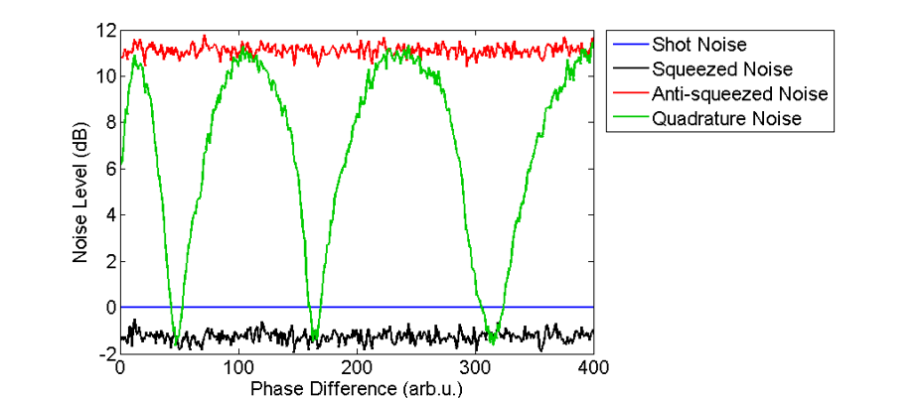
Homodyne Detection scheme

Slide 7
Experimental setup
SMPM fiber $−$single-mode polarization-maintaining fiber
$λ/2 −$ half-wave plate
GP $−$Glan-laser polarizer
PBS $−$ polarizing beam splitter
PhR $−$ phase-retarding wave plate
BPD $−$ balanced photodetector
Parameters affect squeezing:
Pump beam intensity
Beam size
Atomic density of medium
Beam focus position in the cell

Slide 8
Experimental setup
SMPM fiber $−$single-mode polarization-maintaining fiber
$λ/2 −$ half-wave plate
GP $−$Glan-laser polarizer
PBS $−$ polarizing beam splitter
PhR $−$ phase-retarding wave plate
BPD $−$ balanced photodetector
Parameters affect squeezing:
Pump beam intensity
Beam size
Atomic density of medium
Beam focus position in the cell

Slide 9
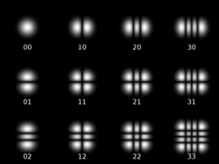
Spatial modes of light
Hermite Gaussian modes
Laguerre Gaussian modes
Figure source: Wikipedia page-Gaussian beam

Slide 10
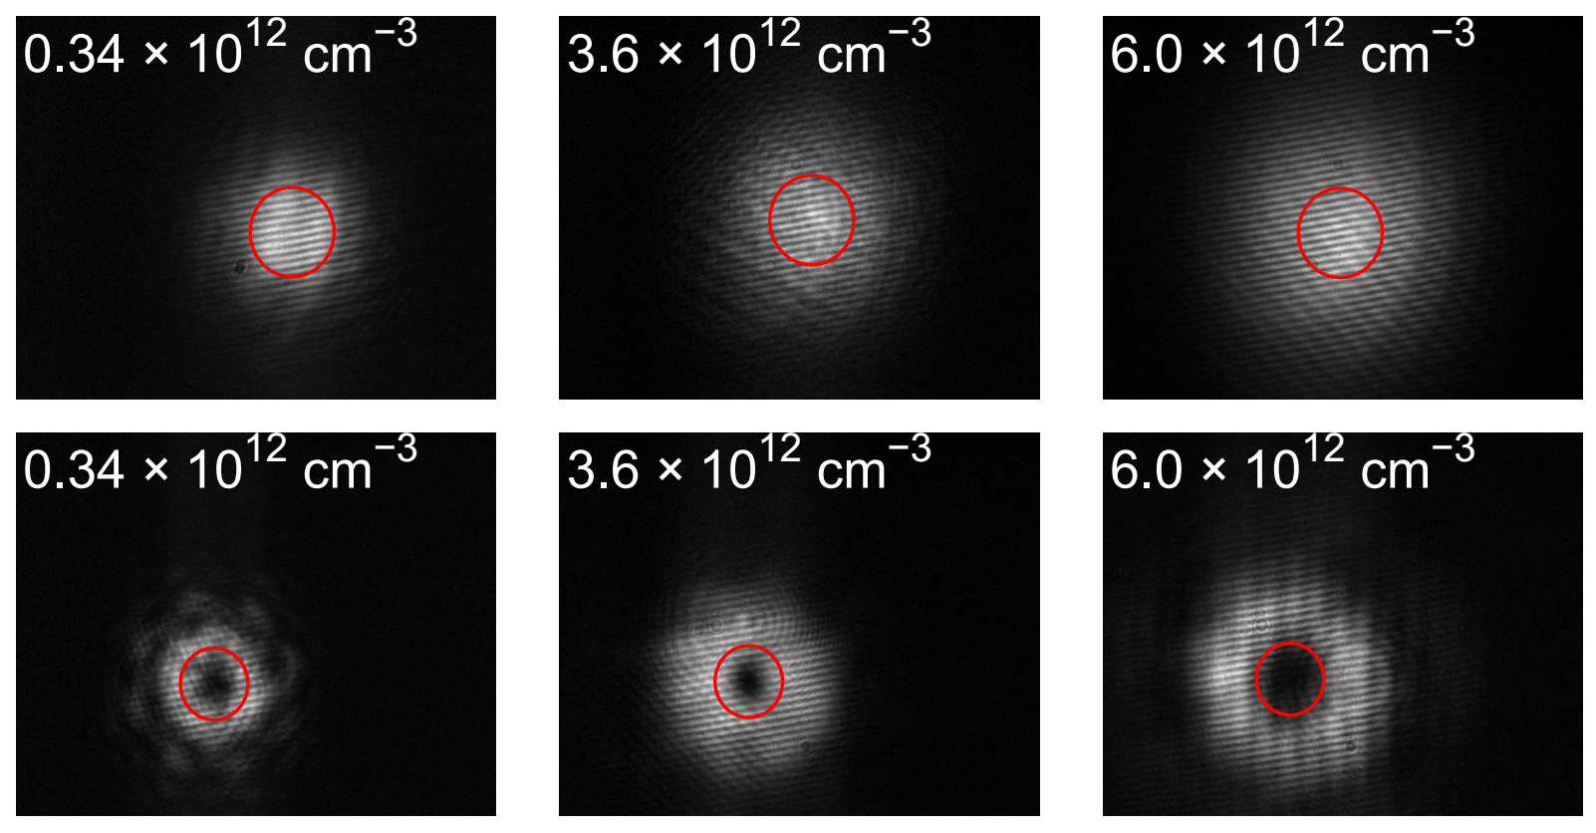
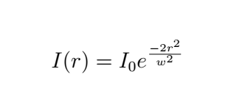
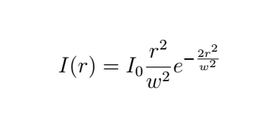
Self-focusing of beam
A nonlinear process in medium,
caused by the intensity distribution change in strong field

Slide 11
Correlation between self squeezing and squeezing

Slide 12
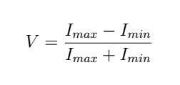
Interferometric scheme of detection
To calibrate a good mode match, we introduce a parameter visibility
Usually in similar detecting scheme, a visibility of 90% is necessary to detect squeezing.
We had V = 98%, but no squeezing was observed.

Slide 13
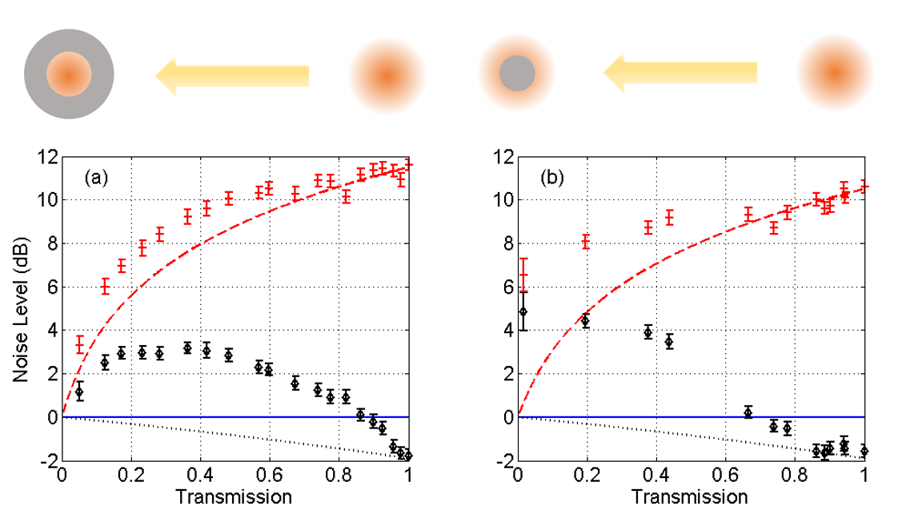
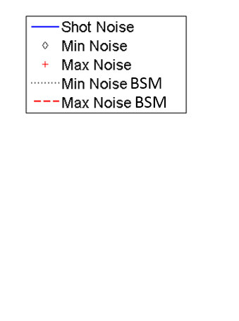
Circular beam mask

Slide 14
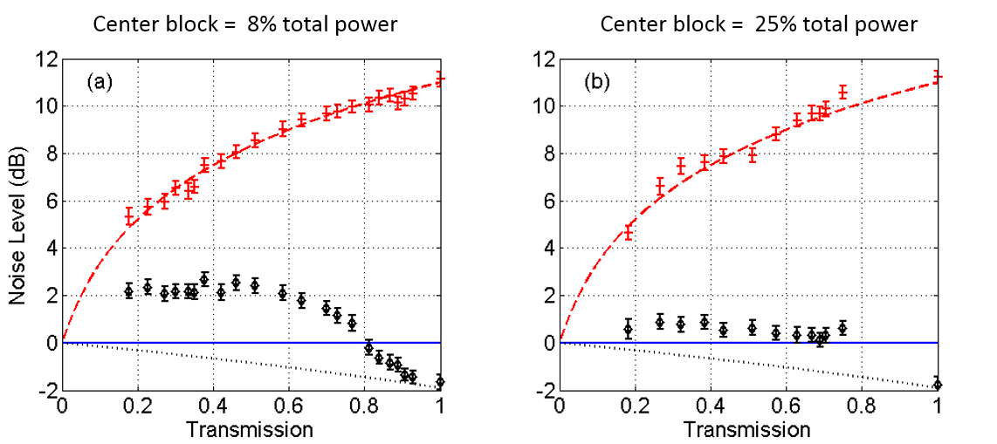
Circular beam mask

Slide 15
“Telescope”

Slide 16
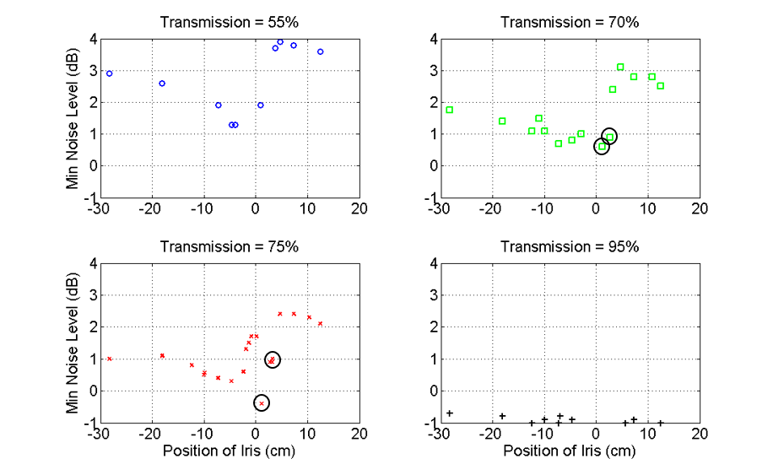
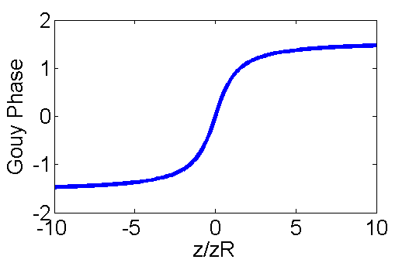
Iris transmission fixed
Guoy Phase $ς\left(z\right)=arctan\left(\frac{z}{z_{R}}\right)$,
has a $π$ shift across the focus

Slide 17
Theoretical explanation
Figure credit: R. N. Lanning

Slide 18
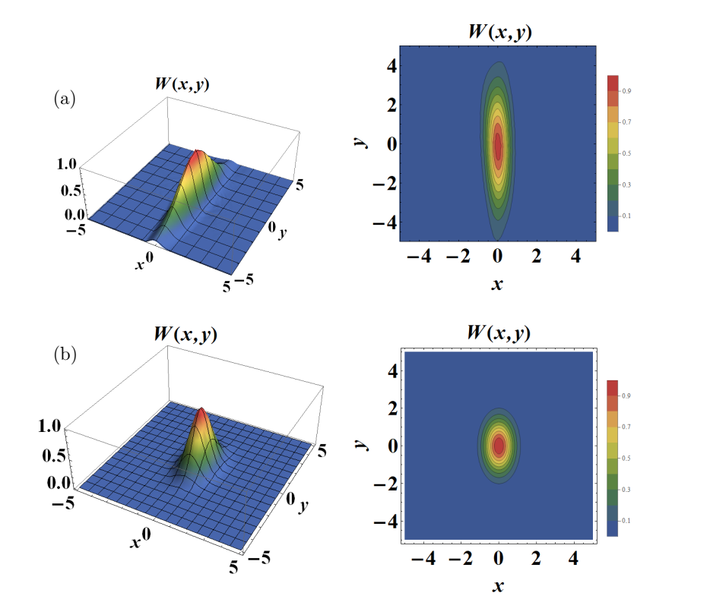
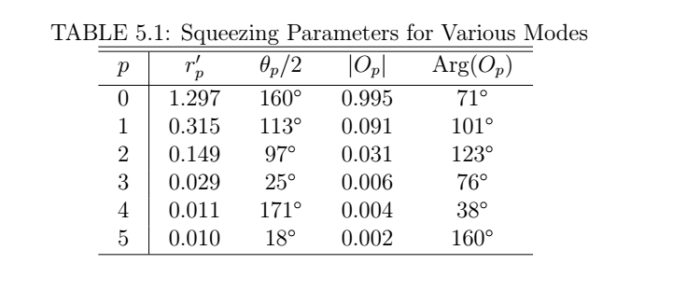
Theoretical explanation
Multi-mode field generated in the vapor cell, resulting in a bad mode match and less effective detection of squeezing.
M Zhang, RN Lanning, Z Xiao, JP Dowling, I Novikova, EE Mikhailov
Physical Review A 93 (1), 013853

Slide 19
Iris size fixed

Slide 20
Optical depth study – multipass

Slide 21
Squeezing dependence on optical depth
$$N=9.3 ×{10}^{11}/{cm}^{3}$$
P = 11 mW
Squeezing = -2.1 dB
$N=4.3 ×{10}^{11}/{cm}^{3}$
P = 11 mW
Squeezing = -2.6 dB
$N=2.4 ×{10}^{11}/{cm}^{3}$
P = 11 mW
Squeezing = -2.4 dB

Slide 22
Squeezing dependence on optical depth

Slide 23
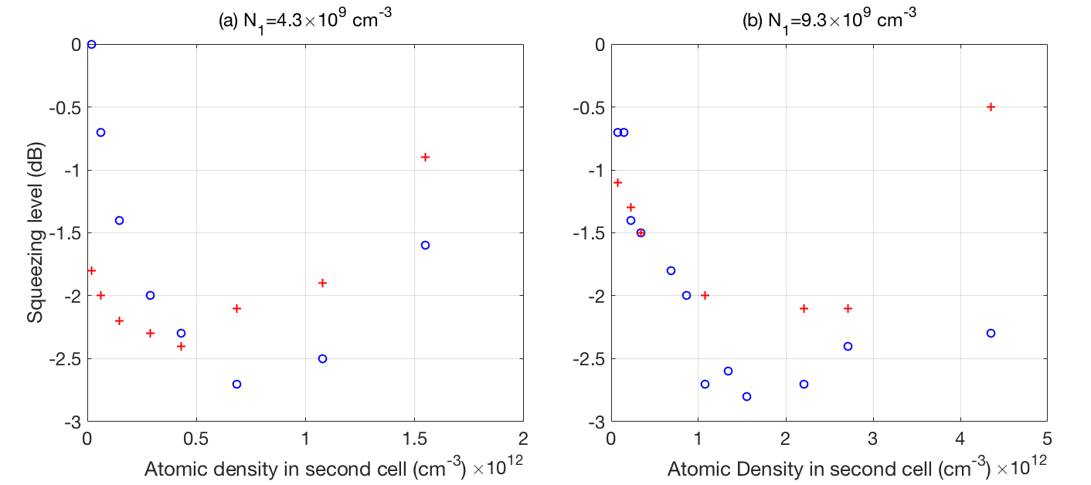
Two cells

Slide 24
Entangled position

Slide 25
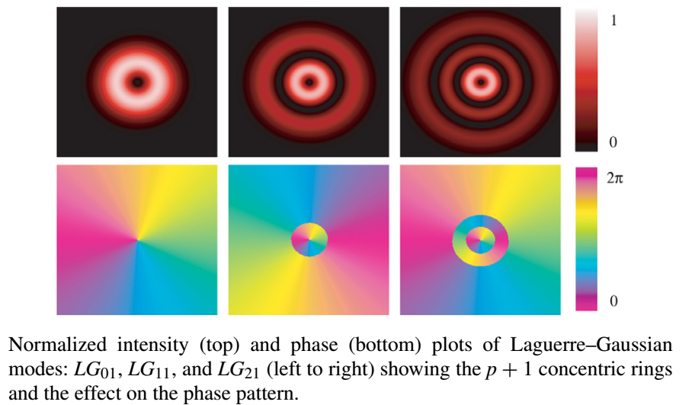
Spatial light modulator
A reflective device that changes the phase retardation of light incident on screen.
Yao, A.M., and Padgett, M.J. (2011) Orbital angular momentum: origins, behavior and applications. Advances in Optics and Photonics, 3 (2). p. 161. ISSN 1943-8206

Slide 26
Change beam shape with SLM-phase modulation

Slide 27
Change of pump
The SLM changes the pump beam shape to generate different amount of noise suppression.
Squeezing is detected by the spectrum analyzer and sent to the optimization algorithm to decide how to modify the phase mask.

Slide 28
Feedback loop and Optimization algorithm
Optimization algorithm – Metropolis
If squeezing is improved, accept change
If not, accept change with a probability
Phase mask applied to the SLM is composed of N higher modes
with l = 0 or p = 0
$$Φ\left(x,y\right)= \sum_{i=1}^{N}{\left(C_{iR}+{iC}_{iI}\right)}Φ_{i}\left(x,y,w\right)$$
$C_{iR}$ is the real coefficient of the ith mode and $C_{iI}$ is the imaginary part.
$Φ\left(x,y\right)$ is the phase applied to a certain position (x, y), $Φ_{i}\left(x,y,w\right)$ is the phase of the ith mode with waist w.

Slide 29
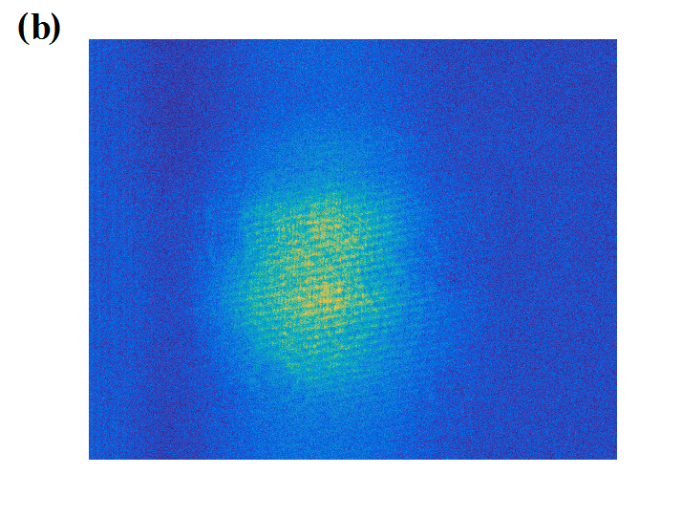
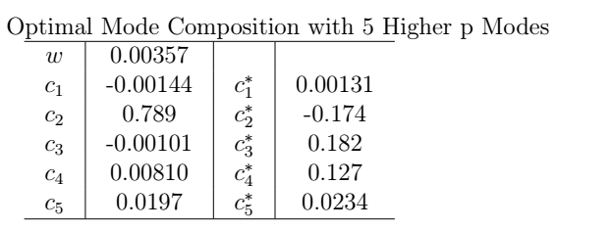
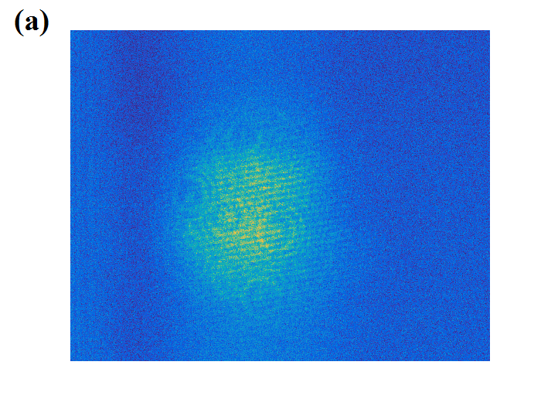
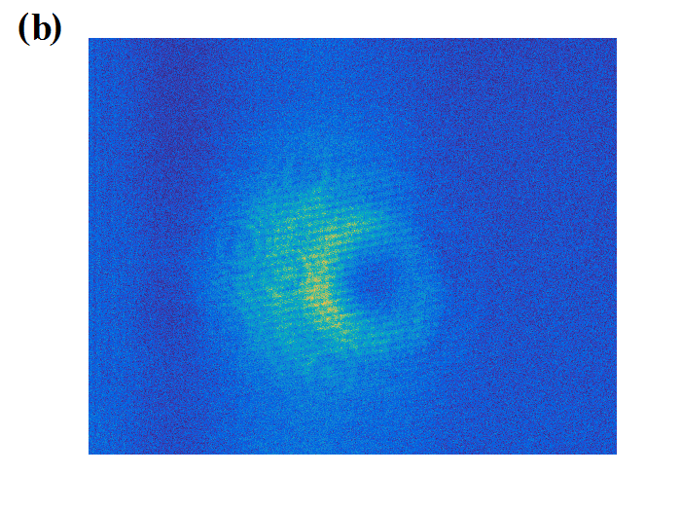
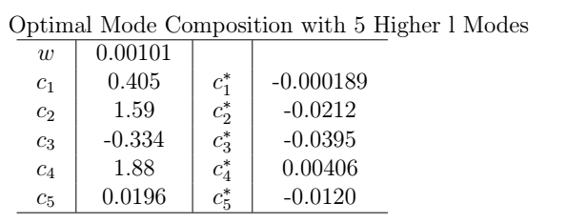
Optimized squeezing
Original squeezing = -2.0 dB
Improved squeezing = -2.3 dB
Original squeezing = -0.7 dB
Improved squeezing = -1.2 dB

Slide 30
Change of Local Oscillator
Original squeezing = -1.8 dB
Squeezing with SLM on = -1.0 dB

Slide 31
Direct observation of beam
Camera: Princeton Instruments PIXIS
Attenuator : neutral density filters

Slide 32
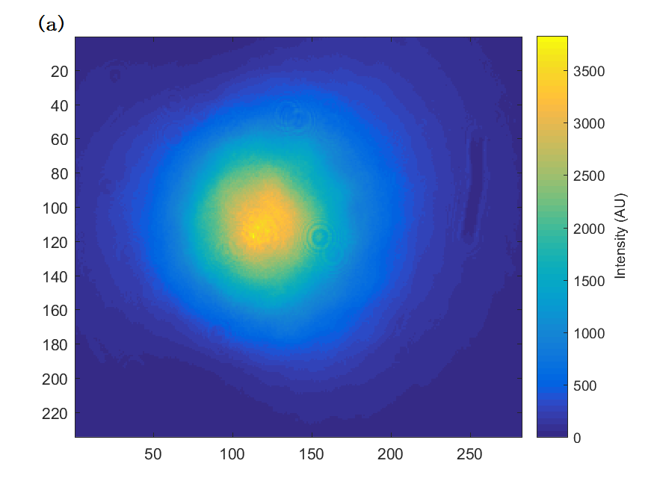
Noise calibration in a coherent beam
Averaged photon number
$$\overline{N}$$
Normalized photon number noise
$$\overline{N}/ΔN^{2}$$
For coherent beam, there should be $ΔN^{2}$= $\overline{N}$
Figure credit: K. T. Kutzke

Slide 33
Noise statistics
Figure credit: K. T. Kutzke

Slide 34
Noise in a local oscillator

Slide 35
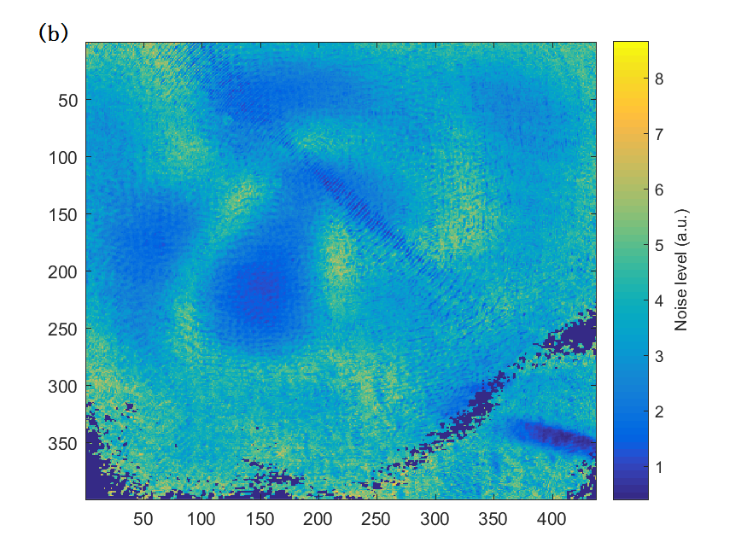
Squeezed field
Averaged photon number
$$\overline{N}$$
Normalized photon number noise
$$\overline{N}/ΔN^{2}$$
The normalized noise map has a clear spatial structure.
Figure credit: K. T. Kutzke

Slide 36
Noise structure in a squeezed vacuum field
Figure credit: K. T. Kutzke

Slide 37
Conclusions
We are able to produce -2.7 dB of squeezing below shot noise
The squeezed vacuum field generated in hot Rb vapor is in a multi-mode structure
The optical depth of medium is not the only factor that determines squeezing
Pump beam shape influences the squeezing generated in the medium, and is possible to improve it.
With a quantum noise limited camera, we can see a spatial dependence of noise in the squeezed vacuum field.

Slide 38
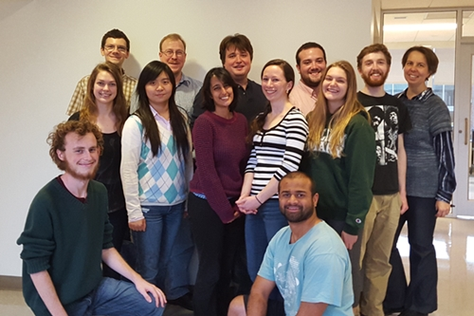
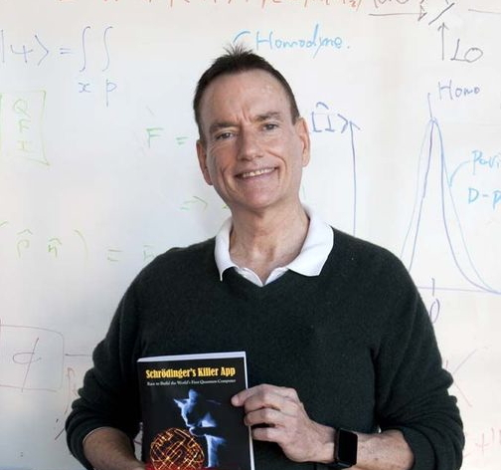
Acknowledgment
This project is supported by AFOSR grant FA9550-13-1-0098.
Louisiana State University
Jonathan P. Dowling
Quantum Optics Group @ College of William and Mary
R. Nicholas Lanning
Zhihao Xiao

