Slide 1
Propagation of quantum optical fields under the conditions of multi-photon resonances in a coherent atomic vapor
Gleb Romanov
3/12/2013

Slide 2
Outline
Squeezed states of light
Previous experiment
Hyper-fine EIT filtering experiment
“Fast” squeezing experiment
Future plans

Slide 3
Squeezed states of light
Coherent state
Squeezed state
$$φ$$
$$X_{2}$$
$$X_{2}$$
$$X_{1}$$
$$X_{1}$$
$E\left(t\right)=ε(ae^{−iωt}+a^{†}e^{iωt})$ -> $E\left(t\right)=2ε(X_{1}\cos{ωt}+X_{2}\sin{ωt})$
$\left[a,a^{†}\right]=1$ $\left[X_{1},X_{2}\right]=\frac{i}{2}$
Coherent state: Squeezed state:
$ΔX_{1}ΔX_{2}=\frac{1}{4}$ $ΔX_{1}ΔX_{2}≥\frac{1}{4}$

Slide 4
Squeezed states of light
Coherent vacuum state
Squeezed vacuum state
$$X_{2}$$
$$X_{2}$$
$$X_{1}$$
$$X_{1}$$
$E\left(t\right)=ε(ae^{−iωt}+a^{†}e^{iωt})$ -> $E\left(t\right)=2ε(X_{1}\cos{ωt}+X_{2}\sin{ωt})$
$\left[a,a^{†}\right]=1$ $\left[X_{1},X_{2}\right]=\frac{i}{2}$
Coherent state: Squeezed state:
$ΔX_{1}ΔX_{2}=\frac{1}{4}$ $ΔX_{1}ΔX_{2}≥\frac{1}{4}$

Slide 5
Polarization self-rotation
$$φ_{sr}\sim ε$$
Laser beam
$$ε$$
Resonant media
$$φ_{sr}≃\frac{3}{4 π}N λ^{2}\frac{γ}{∆}L ε$$
I. Novikova et al., JMO 49, 14/15 2565-2581 (2002)

Slide 6
Polarization self-rotation
PBS
Horizontally polarized
pump field
Vertically polarized
squeezed vacuum field
A.B. Matsko et al., PRA 66, 043815 (2002)

Slide 7
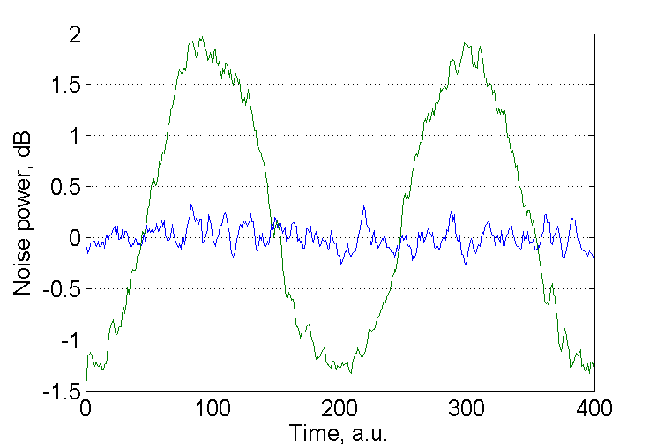
Detection of squeezed vacuum
Squeezed vacuum state
BPD
$$X_{2}$$
50/50 BS
Spectrum analyzer
$$∼\overline{E_{LO}}\left\langle ΔE_{sq}\right\rangle$$
$$X_{1}$$
Local oscillator
$$X_{2}$$
PZT
$$X_{1}$$
Hans-A. Bachor, Timothy C. Ralph “A Guide to Experiments in Quantum Optics”

Slide 8
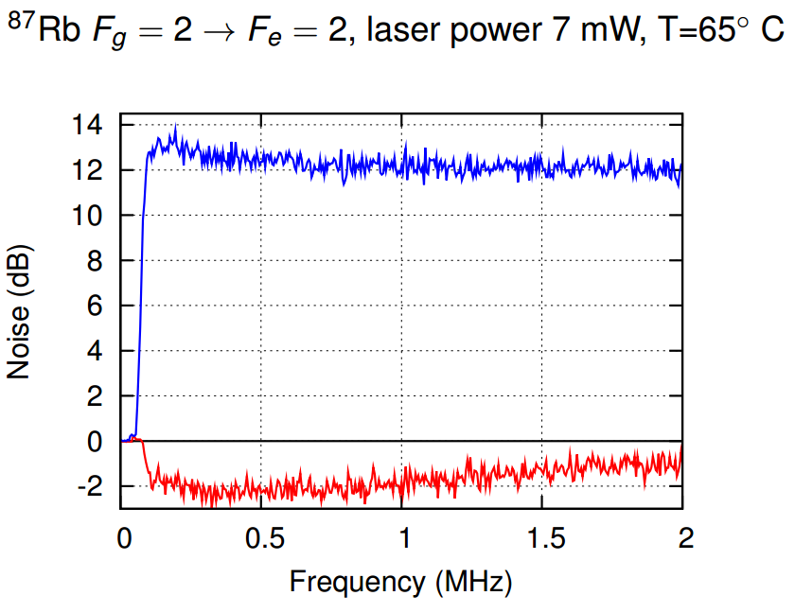
Detection of squeezed vacuum
Squeezed vacuum state
BPD
$$X_{2}$$
50/50 BS
Spectrum analyzer
$$∼\overline{E_{LO}}\left\langle ΔE_{sq}\right\rangle$$
$$X_{1}$$
Local oscillator
$$X_{2}$$
PZT
$$X_{1}$$

Slide 9
Detection of squeezed vacuum
Squeezed vacuum state
Coherent vacuum state
$$X_{2}$$
$$X_{2}$$
$$X_{1}$$
$$X_{1}$$

Slide 10
Detection of squeezed vacuum
Squeezed vacuum state
Coherent vacuum state
$$X_{2}$$
$$X_{2}$$
PBS
$$X_{1}$$
$$X_{1}$$
Coherent vacuum state
$$X_{2}$$
$$X_{1}$$

Slide 11
Detection of squeezed vacuum
Squeezed vacuum state
Coherent vacuum state
$$X_{2}$$
$$X_{2}$$
PBS
$$X_{1}$$
$$X_{1}$$

Slide 12
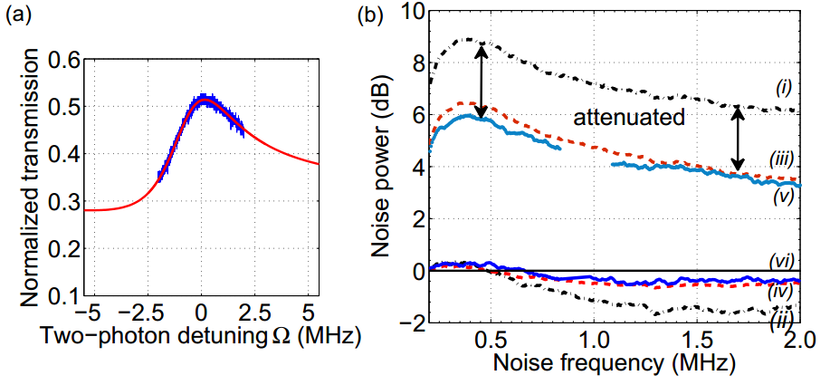
Beam splitter model
$$\left(\begin{matrix}V_{+,out} \\ V_{−,out}\end{matrix}\right)=\left(\begin{matrix}{A_{+}}_{}^{2} & {A_{−}}_{}^{2} \\ {A_{−}}_{}^{2} & {A_{+}}_{}^{2}\end{matrix}\right)\left(\begin{matrix}V_{+,in} \\ V_{−,in}\end{matrix}\right)+\left(\begin{matrix}1−({A_{+}}_{}^{2}+{A_{−}}_{}^{2}) \\ 1−({A_{+}}_{}^{2}+{A_{−}}_{}^{2})\end{matrix}\right)$$
Where $A_{±}=\frac{1}{2}(T(ω)±T(−ω))$
$T(ω)$ – normalized transmission at the frequency $ω$
$V_{±,in}$ - input noise variance
$V_{±,out}$ - output noise variance
Eugeniy E. Mikhailov et al., PRA 73, 053810 (2006)

Slide 13
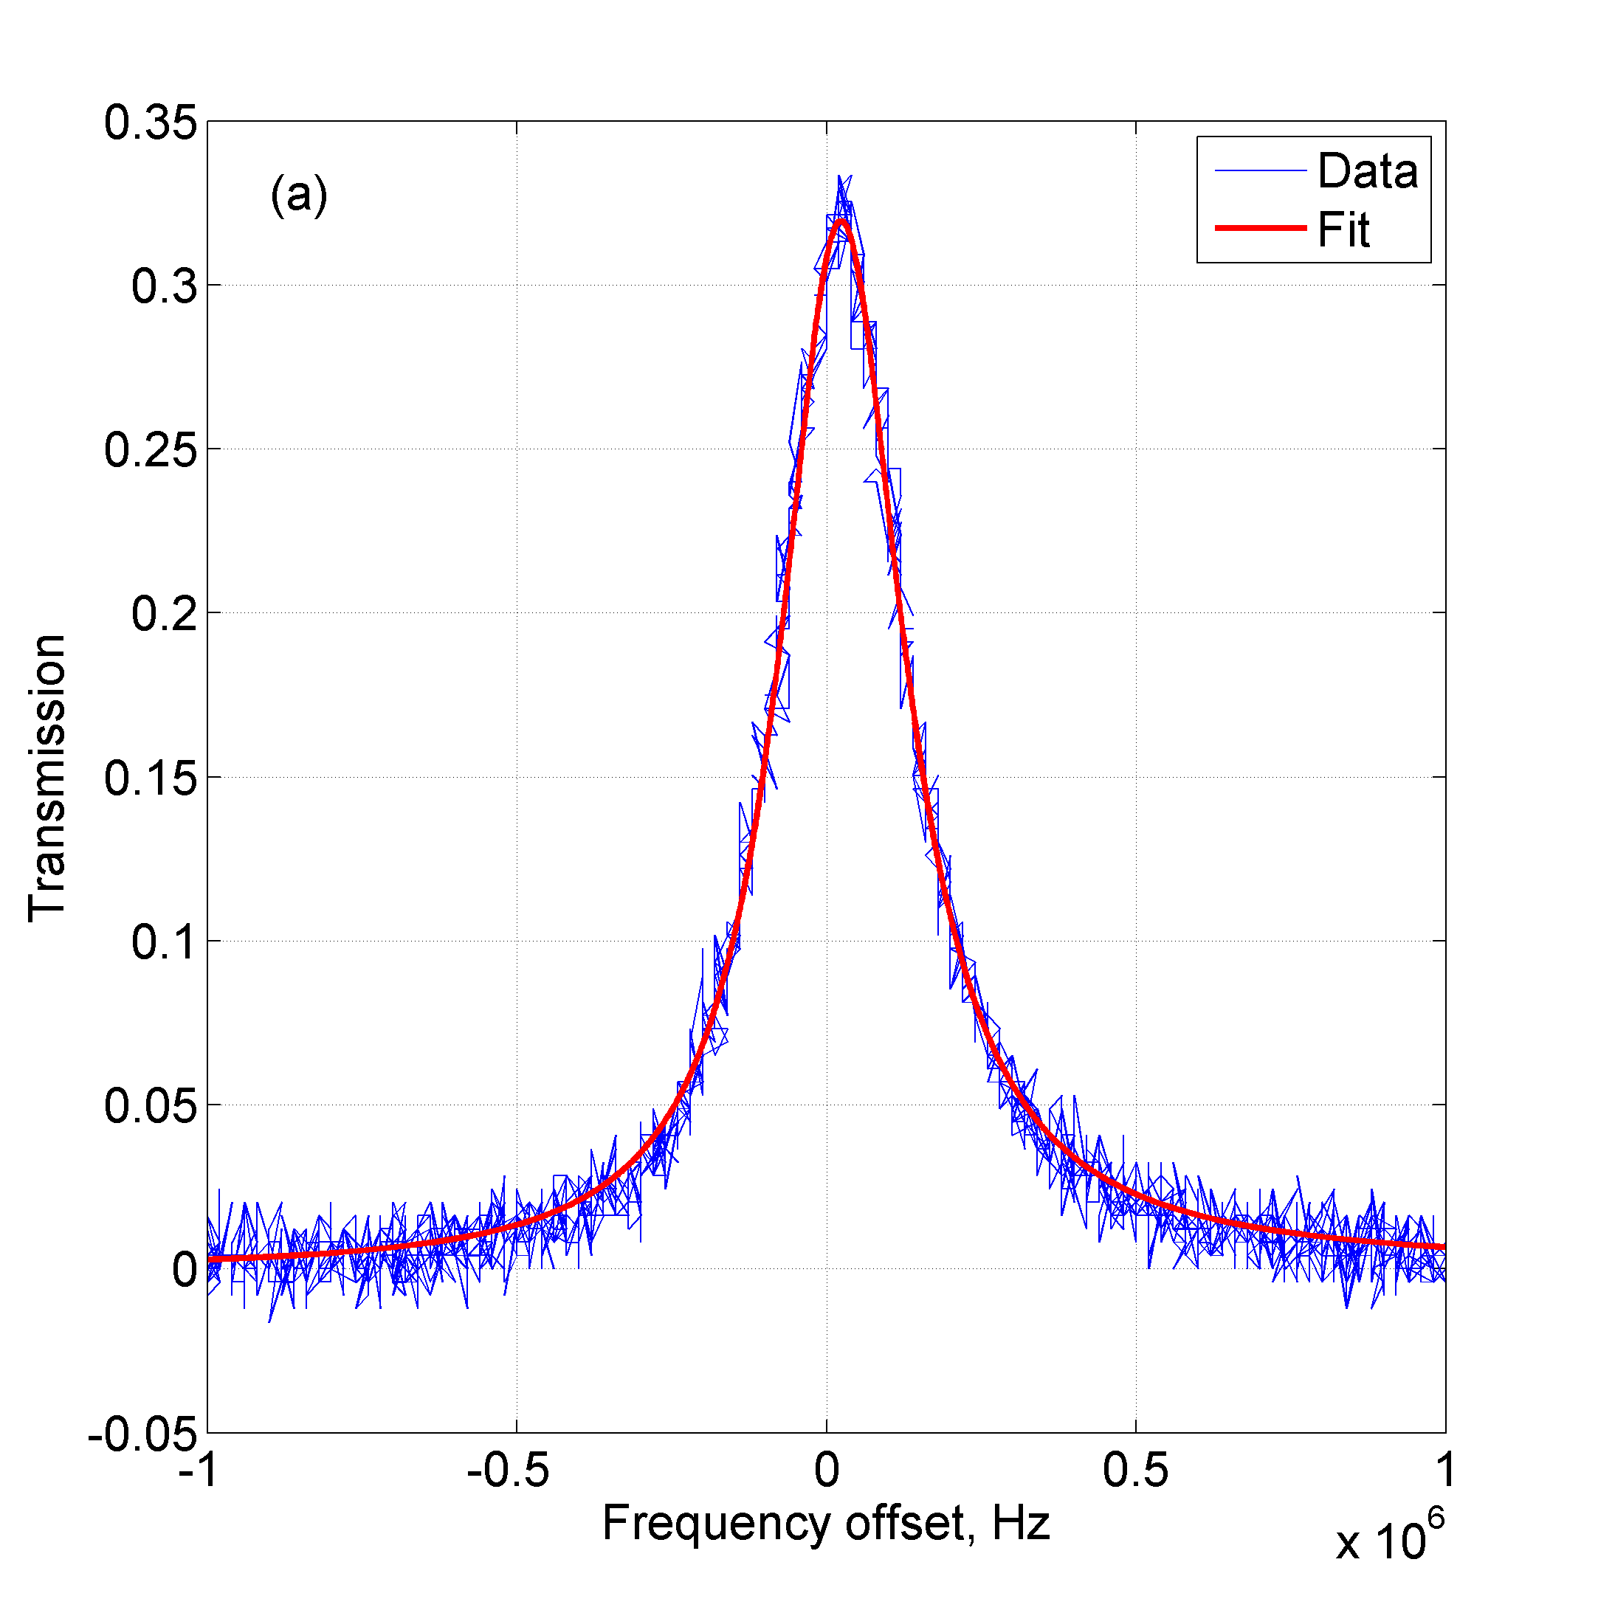
Electromagnetically induced transparency (EIT)
$$δ$$
$$| e>$$
$$Ω$$
$$ε$$
$$| s>$$
$$| g>$$

Slide 14
Outline
Squeezed states of light
Previous experiment
Hyper-fine EIT filtering experiment
“Fast” squeezing experiment
Future plans

Slide 15
Previous experiment
The atoms: ⁸⁷Rb
Simple model
Real atoms
$$δ$$
F`=2
$$δ$$
$$| e>$$
$$Ω$$
$$ε$$
$$| s>$$
$$| g>$$
F=2
$$Δ_{HF}$$
F=1
= populated
(Zeeman structure shown)

Slide 16
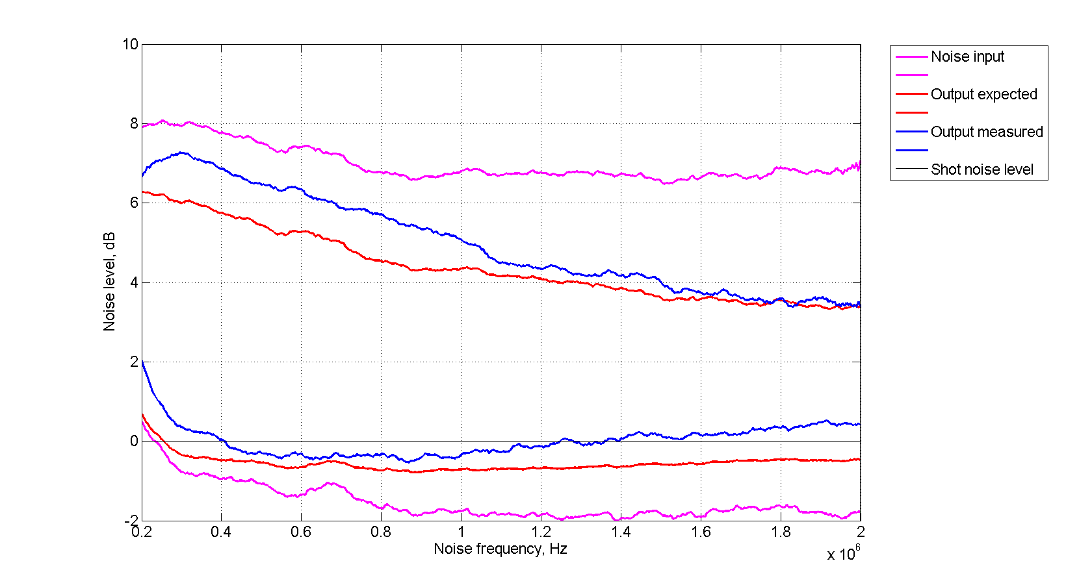
Previous experiment
Sample data
$$X_{1}$$
$$X_{2}$$

Slide 17
Outline
Squeezed states of light
Previous experiment
Hyper-fine EIT filtering experiment
“Fast” squeezing experiment
Future plans

Slide 18
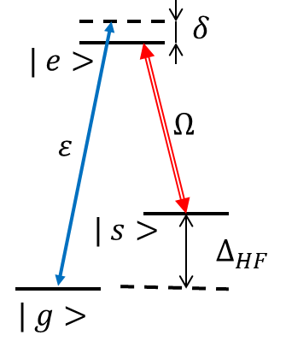
Experimental setup
control
probe
λ/2
OI
Slave
L1
L2
ECDL
EOM
λ/2
PBS
Etalon
$$∆_{HF}=6.835 GHz for {}_{}^{87}{Rb}$$

Slide 19
Experimental setup
PD1
EIT cell
PD2
λ/2
PBS
PBS
control
BPD
ND
probe
PBS
50/50 BS
bypass
LO
PBS
L1
L2
λ/2
λ/2
PZT
PBS
PBS
PBS
Squeezing cell
λ/2

Slide 20
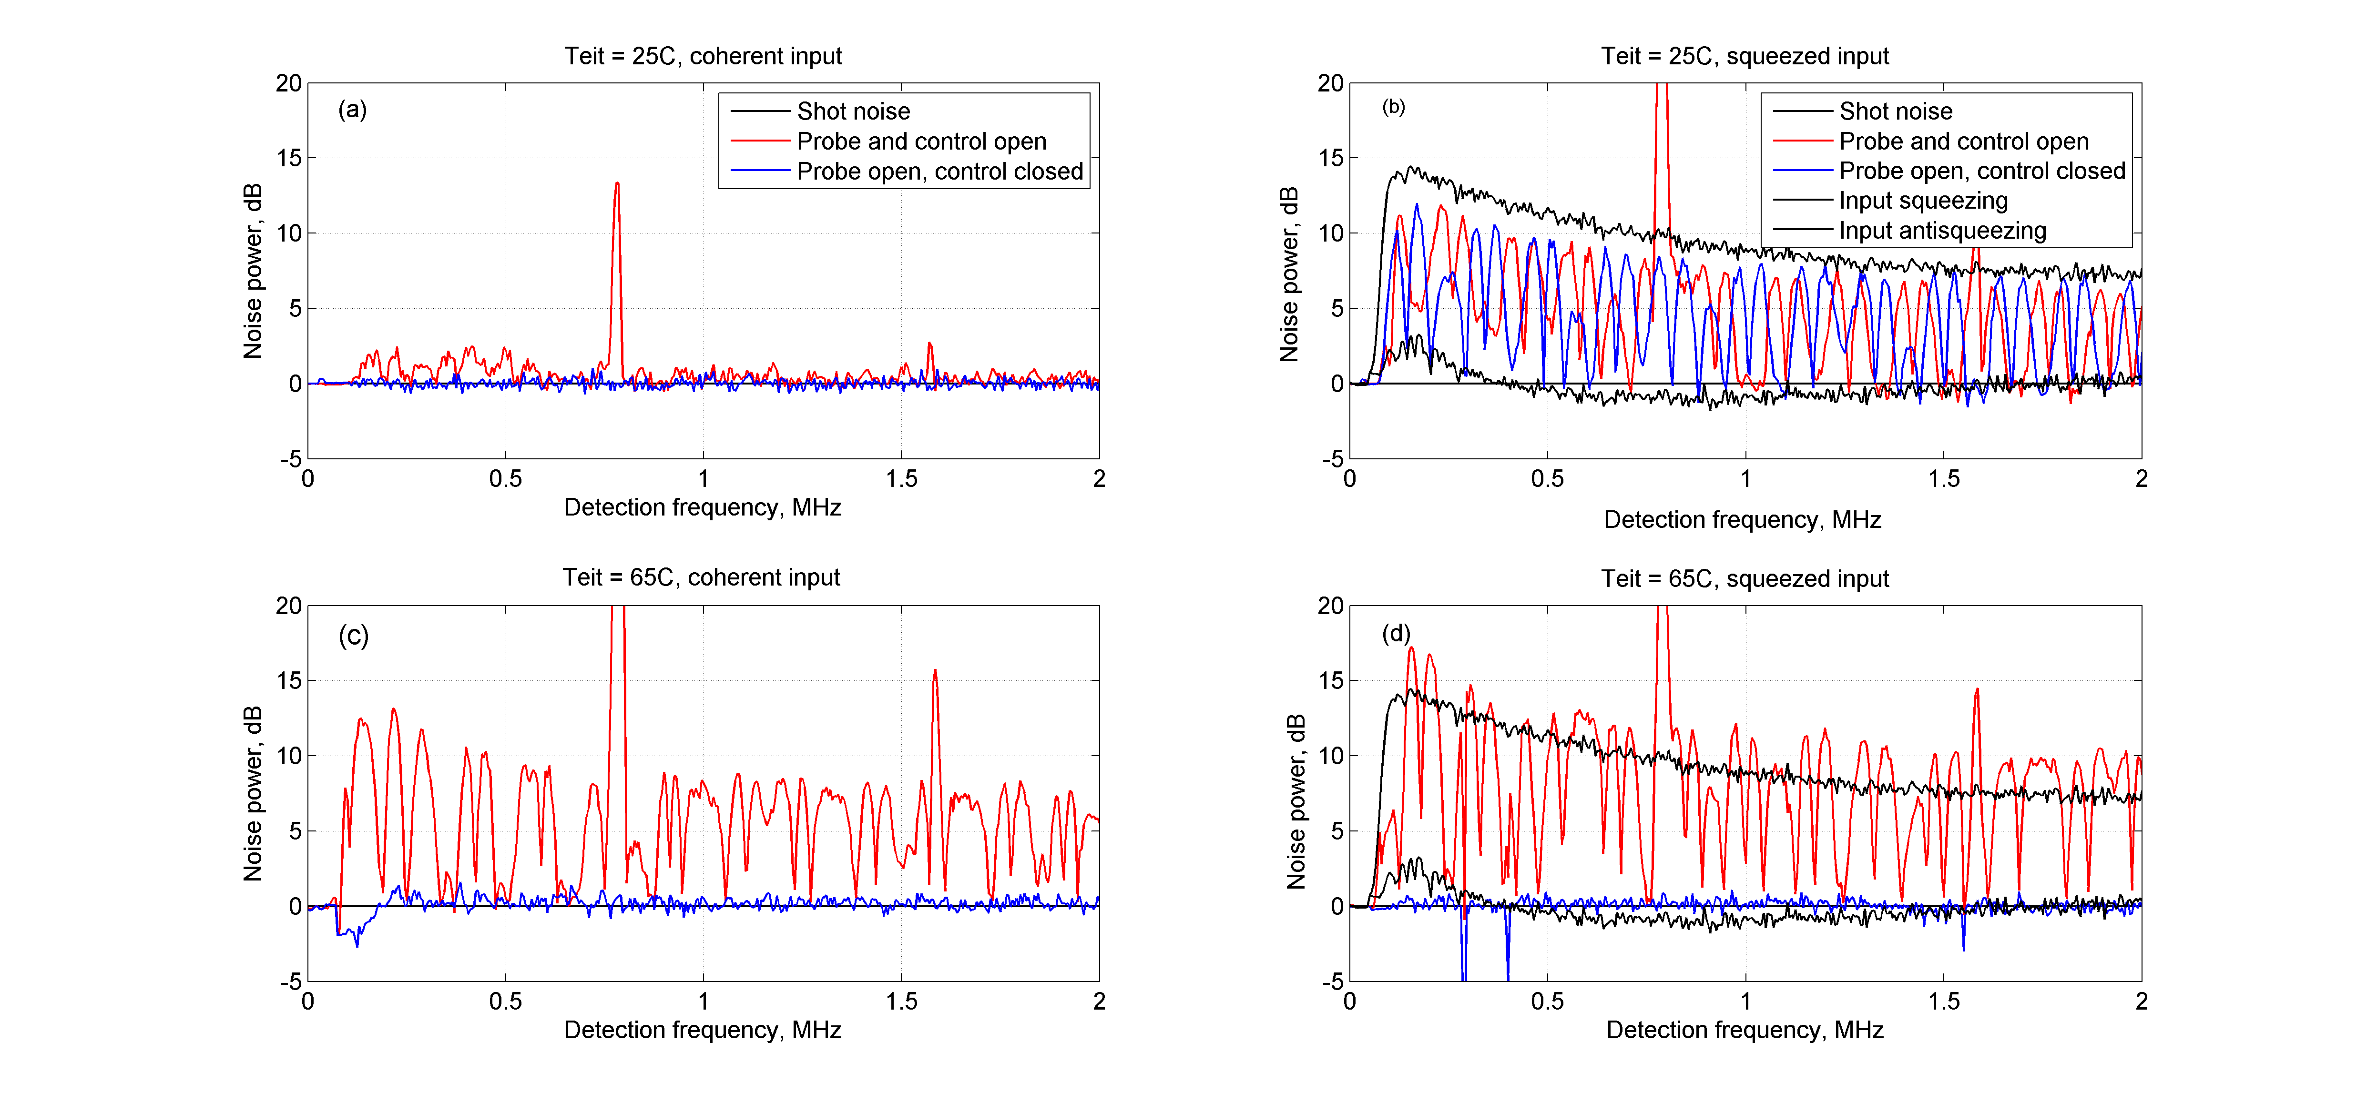
Experimental results
+ Squeeze angle scan

Slide 21
Experimental results

Slide 22
Experimental results

Slide 23
Experimental setup
PD1
EIT cell
PD2
λ/2
PBS
PBS
control
BPD
ND
probe
PBS
50/50 BS
bypass
LO
PBS
L1
L2
λ/2
λ/2
PZT
PBS
PBS
PBS
Squeezing cell
λ/2

Slide 24
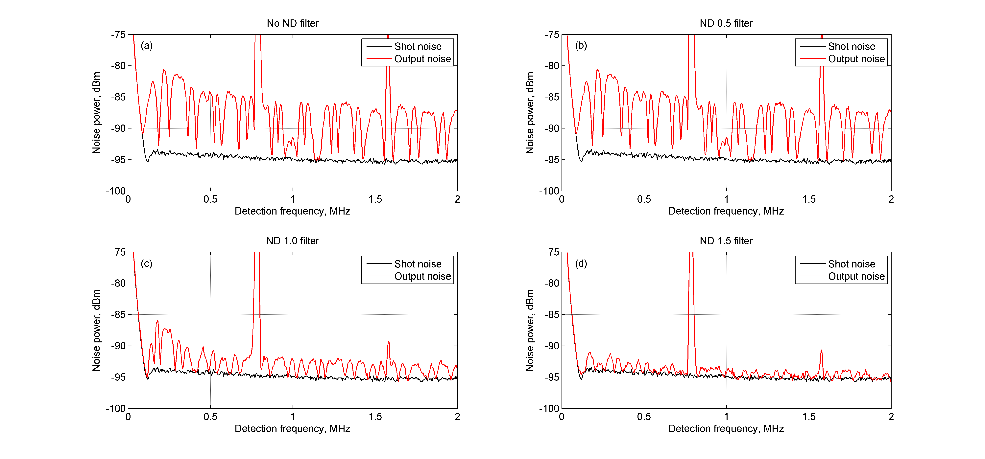
Excess noise power for different coherent probe input powers.

Slide 25
Improved setup
BPD
Local oscillator
50/50 BS
bypass
control
EIT cell
L1
L2
GP
GP
PBS
PBS
Squeezing cell
λ/2
Pump leakage reduced from 0.5 uW to 20 nW

Slide 26
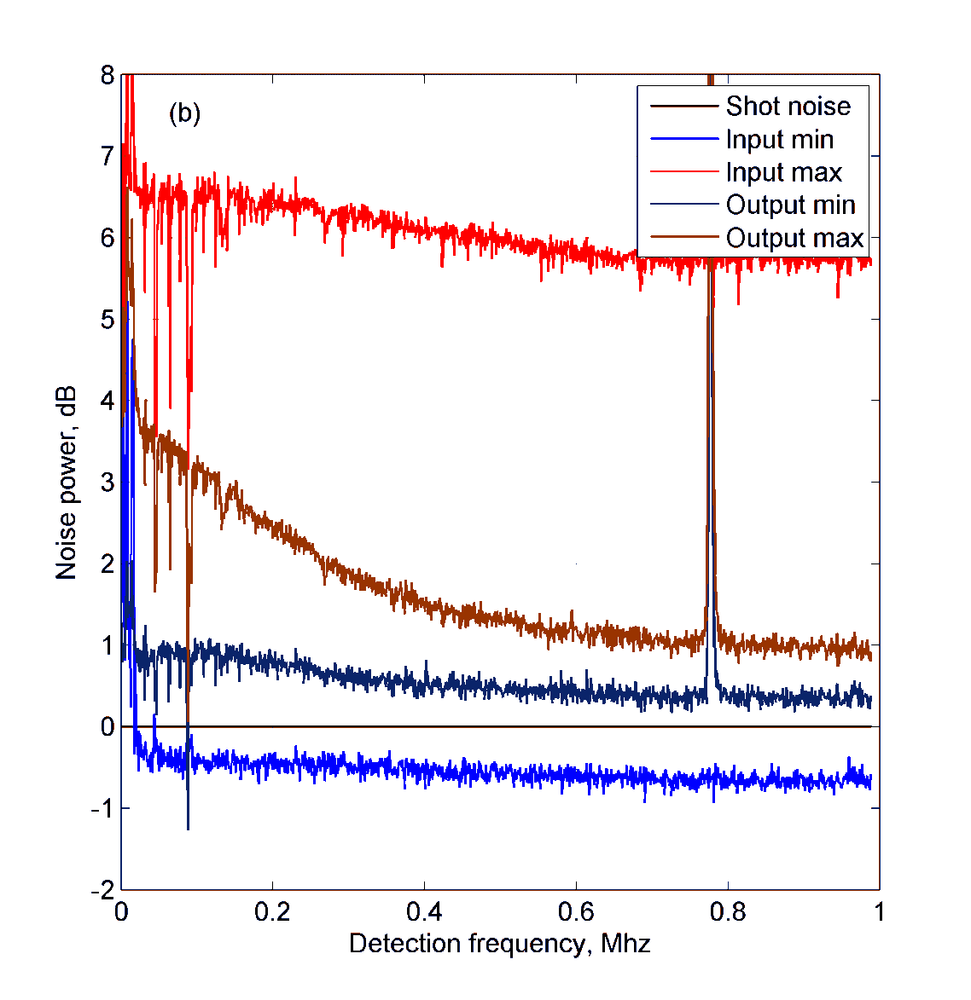
Experimental results

Slide 27
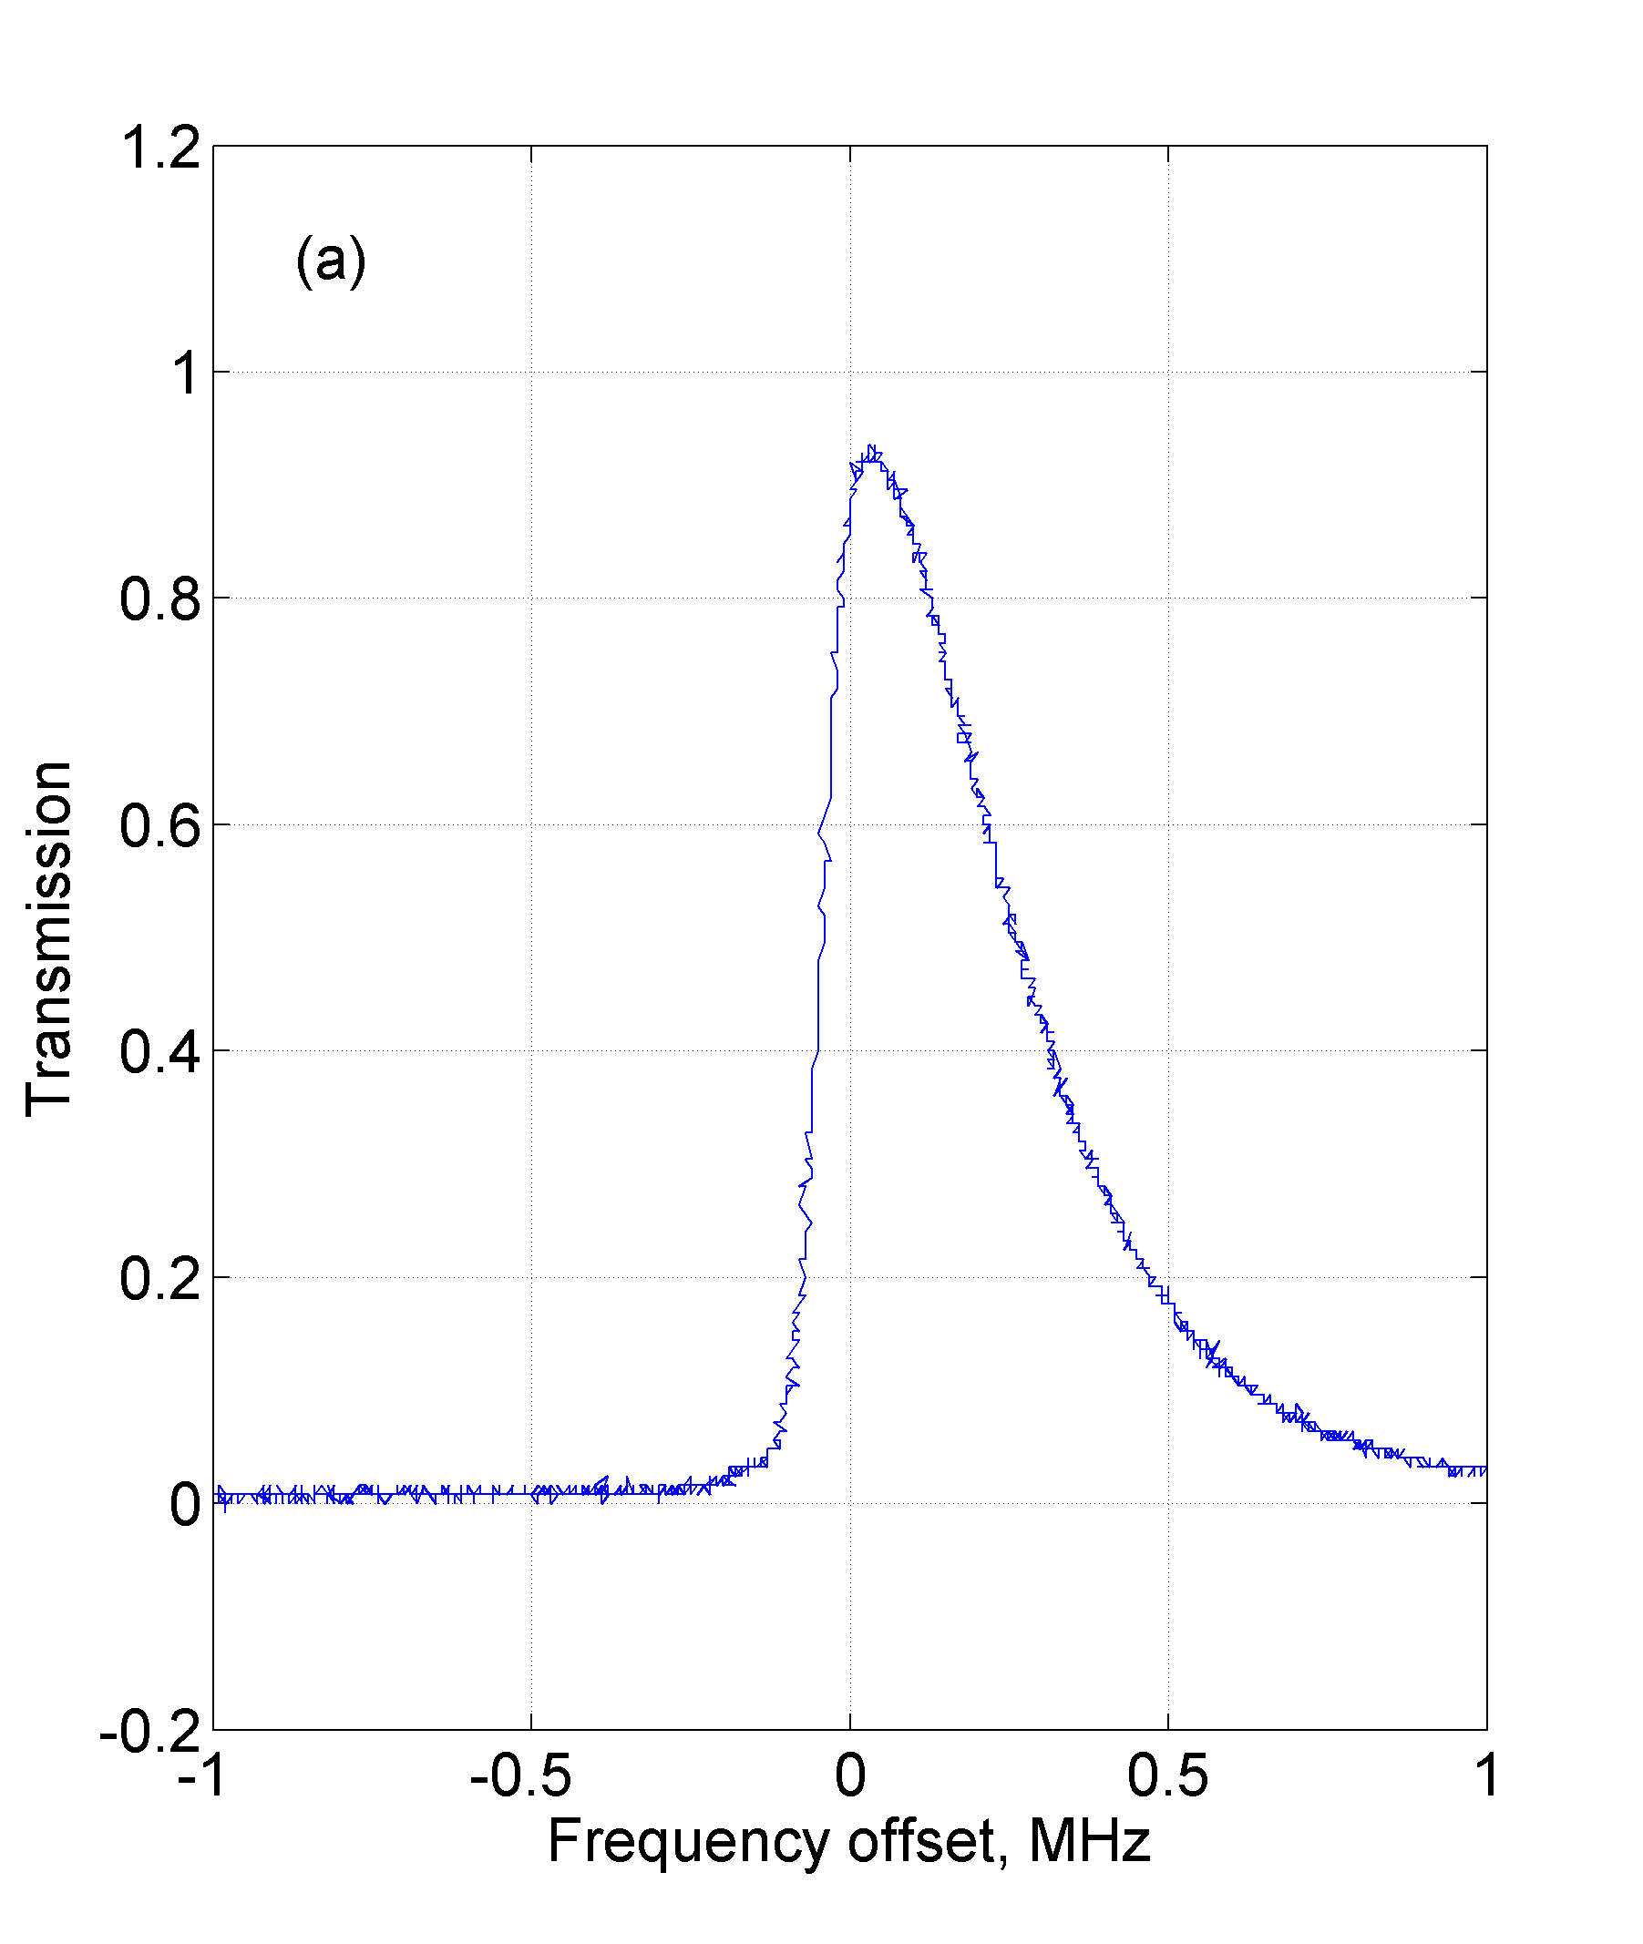
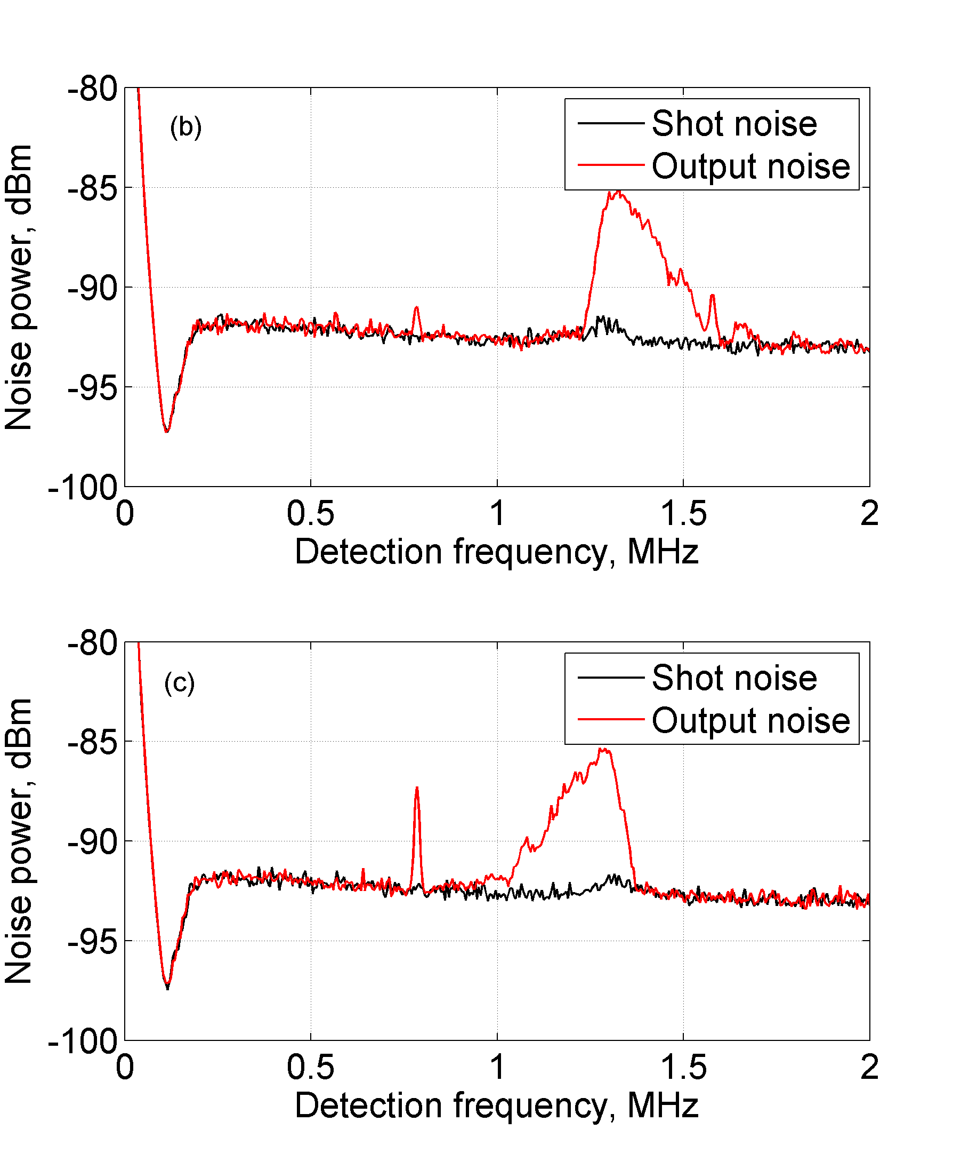
Probing dense atomic media with noise

Slide 28
Outline
Squeezed states of light
Previous experiment
Hyper-fine EIT filtering experiment
“Fast” squeezing experiment
Future plans

Slide 29
“Fast” squeezing experiment motivation
Phys. Rev. Letters 86 (2001) 3925 A. Kuzmich et al., “Signal Velocity, Causality, and Quantum Noise in Superluminal Light Pulse Propagation”
Journal of Optics 12 (2010) 104007 R. W. Boyd et al., “Noise properties of propagation through slow- and fast-light media”

Slide 30
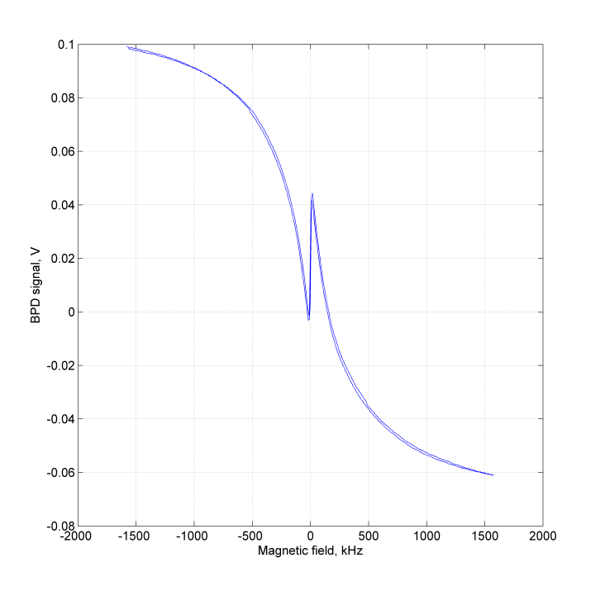
Faraday rotation
BPD
λ/2
PBS
Interaction cell

Slide 31
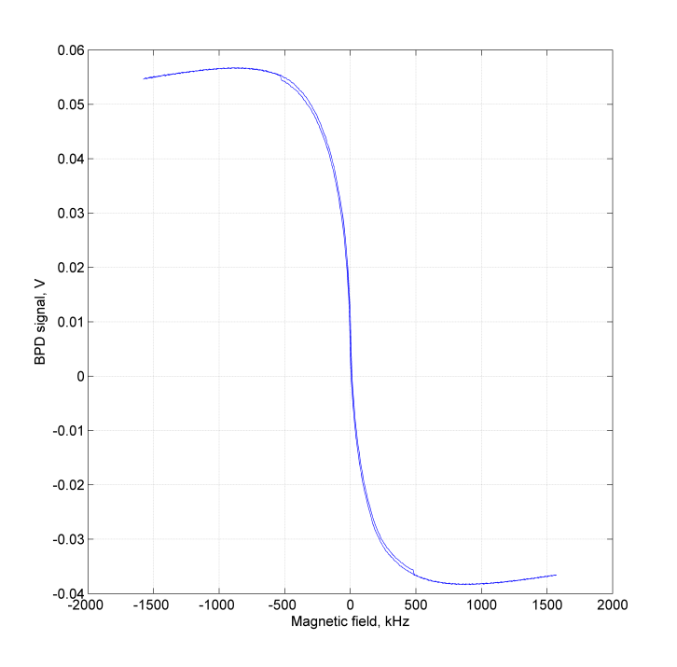
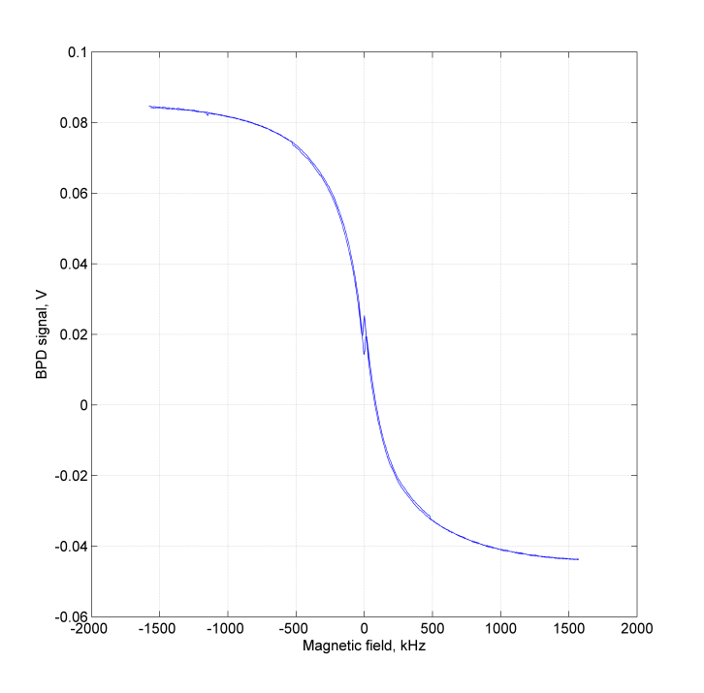
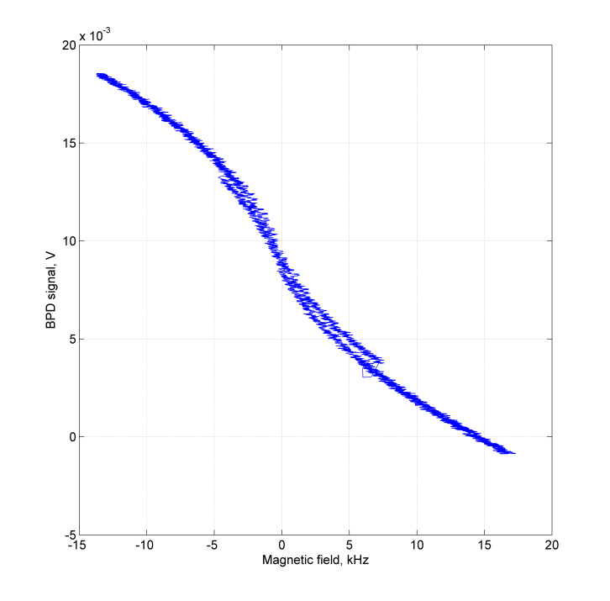
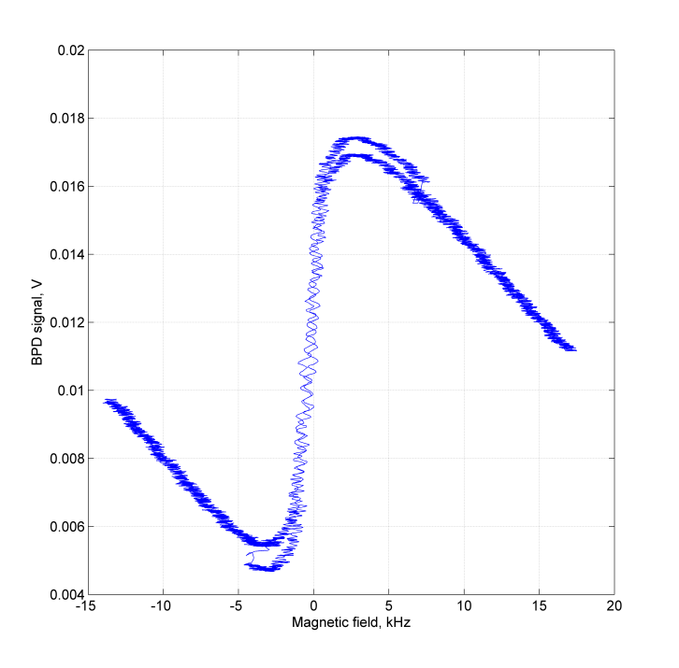
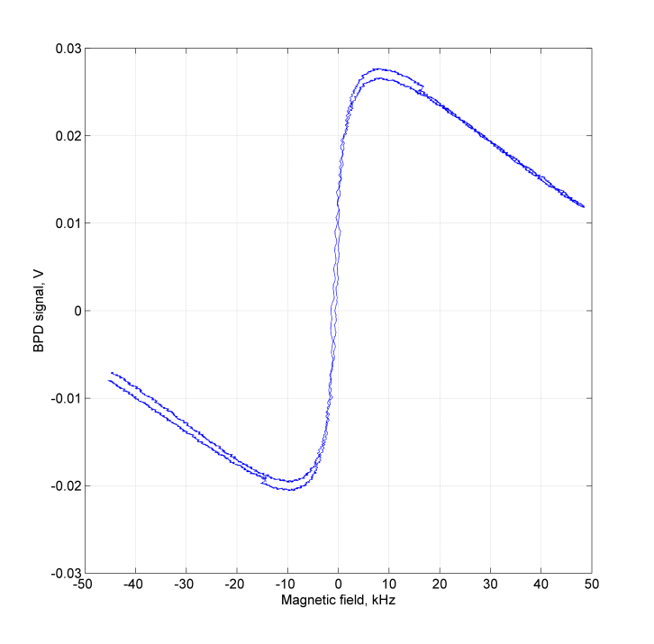
Faraday rotation
1.8 mW
5.4 mW
10.8 mW
BPD signal vs magnetic field in the interaction cell ${}_{}^{87}{Rb},F=2 →F′=1,T=50 {}_{}^{o}C$

Slide 32
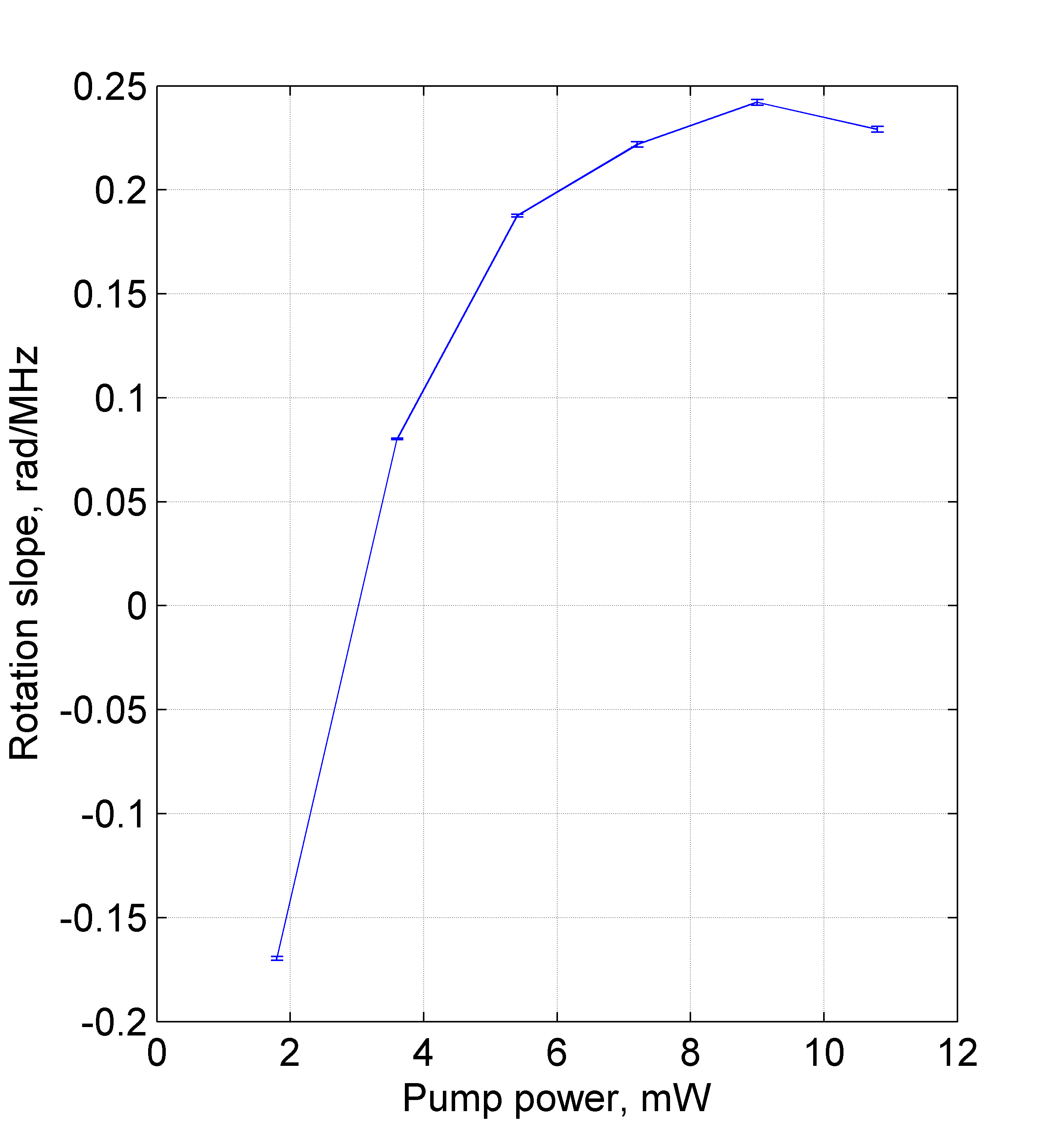
Group velocity
$$υ_{g}=\frac{c}{n+ω\frac{∂n}{∂ω}}$$

Slide 33
Experimental setup
Squeezed vacuum state
+ Local oscillator
$$X_{2}$$
Spectrum analyzer
$$X_{1}$$
BPD
bypass
λ/4
λ/2
PBS
PBS
L1
L2
GP
Squeezing cell
Interaction cell
A. Lezama et al., Phys. Rev. A 84 (2011) 033851

Slide 34
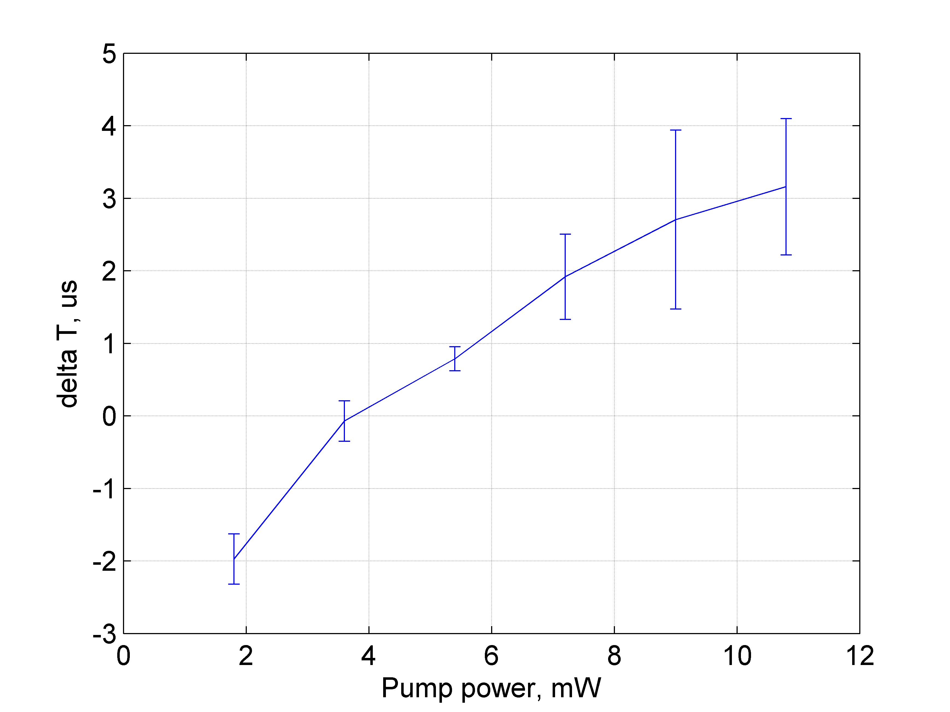
Results
Error bars are $±2σ$ from statistics

Slide 35
Future plans
Finish “fast” squeezing experiment
Optical gyroscopes based on slow/fast light

Slide 36
Summary
Fully atomic generation and manipulation of squeezing
$\sim 2$ dB of noise suppression
It is important to keep the pump leakage as small as possible
Can probe dense atomic media with noise
Demonstration of superluminal squeezing propagation

Slide 37
EIT effect
Consider a 3 level system with two optical fields:
Weak probe field $ε$
Strong control field with the Rabi frequency $Ω$
$$δ$$
$$| e>$$
$$Ω$$
$$ε$$
$$| s>$$
$$| g>$$

Slide 38
EIT effect
Consider a 3 level system with two optical fields:
Weak probe field $ε$
Strong control field with the Rabi frequency $Ω$
Electric susceptibility:
$χ\left(δ\right)=\frac{N}{V}\frac{{D_{eg}}^{2}}{ε_{0}ℏ}\frac{δ+iγ_{0}}{{|Ω|}^{2}+Γ_{0}Γ}$
Where $D_{eg}$- electric dipole moment
$Γ_{0}=γ_{0}−iδ$
$Γ =γ−iδ$
$γ$ – atomic polarization decay rate
$γ_{0}$ - coherence decay rate
$$δ$$
$$| e>$$
$$Ω$$
$$ε$$
$$| s>$$
$$| g>$$

Slide 39
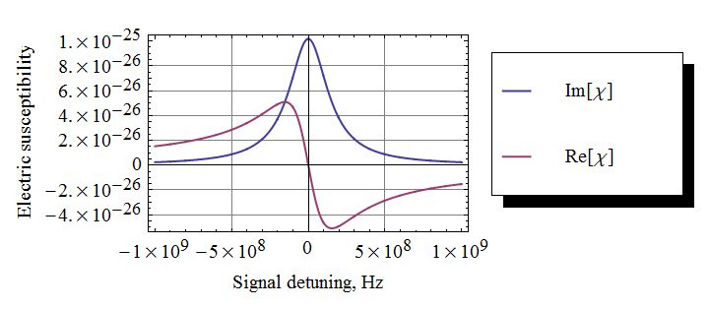
EIT effect
$$δ$$
$$| e>$$
$$ε$$
$$| s>$$
$$| g>$$

Slide 40
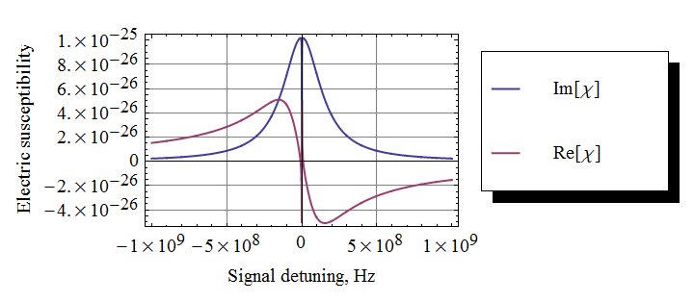
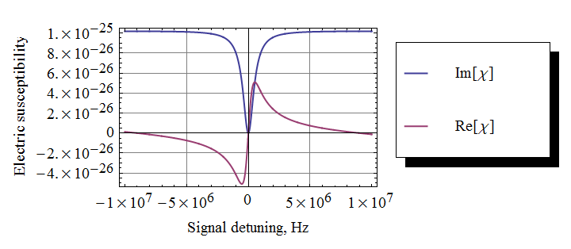
EIT effect
$$δ$$
$$| e>$$
$$Ω$$
$$ε$$
$$| s>$$
$$| g>$$

Slide 41
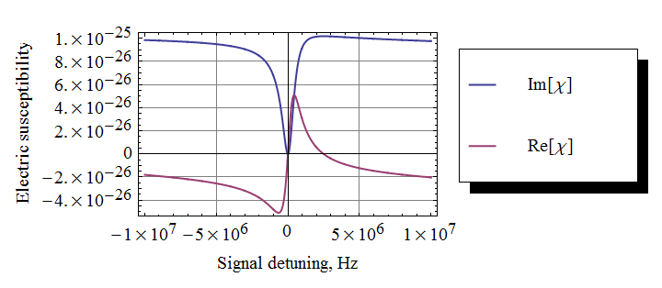
EIT effect
$$δ$$
$$Δ$$
$$| e>$$
$$Ω$$
$$ε$$
$$| s>$$
$$| g>$$
$$Δ=30 MHz$$
$$γ=150 MHz$$

